Slide 1
Georgia Tech Design Lab Presentation
Wednesday, November 15th, 2017

Slide 2
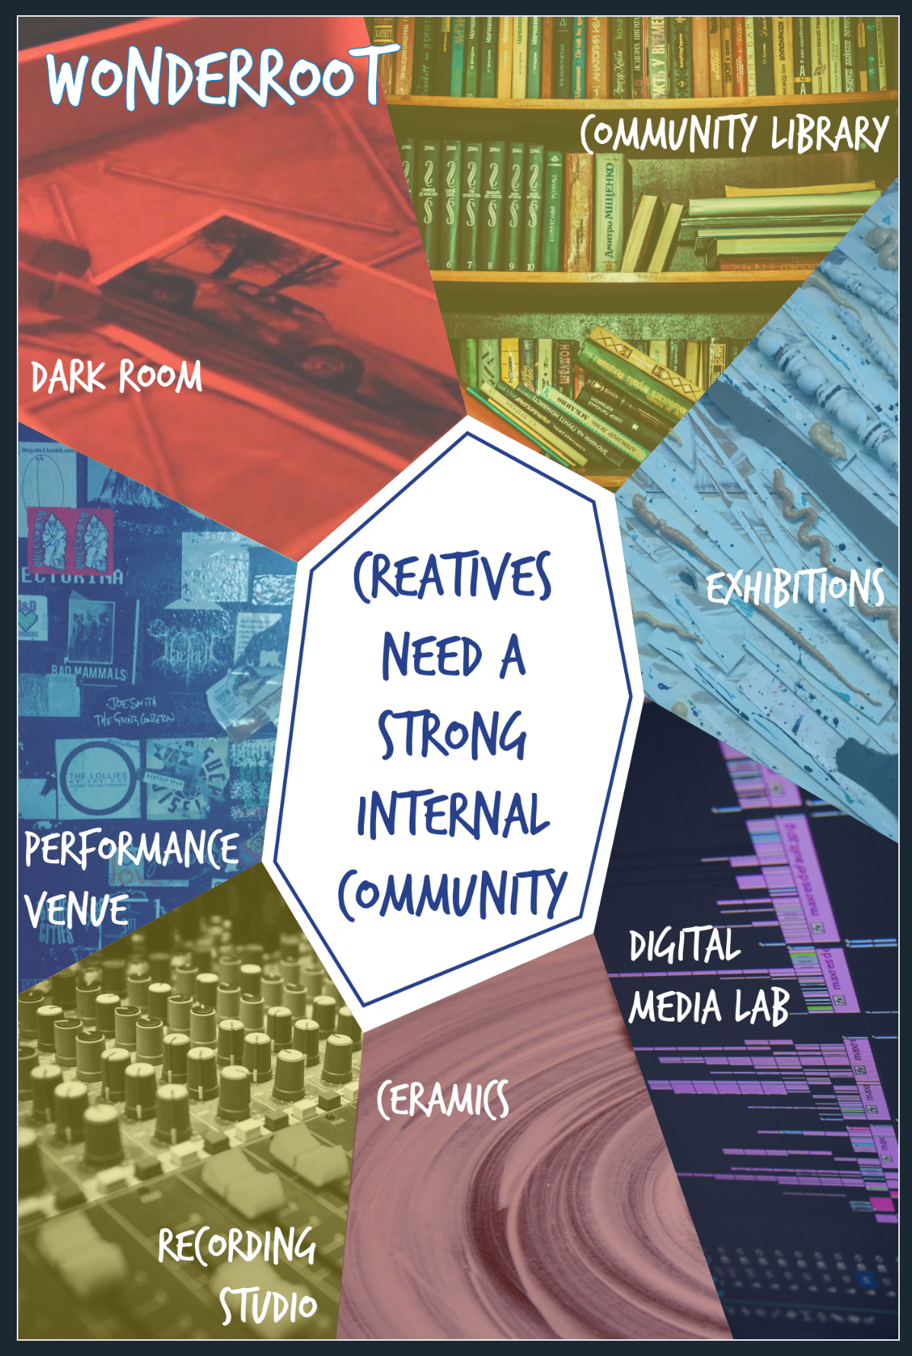
What Georgia Tech Design Lab did for WonderRoot
They gained an understanding of the experience of WonderRoot through interviews and video documentation.
The students employed design thinking methods to obtain and use feedback from non-buyers and propose solutions.

Slide 3
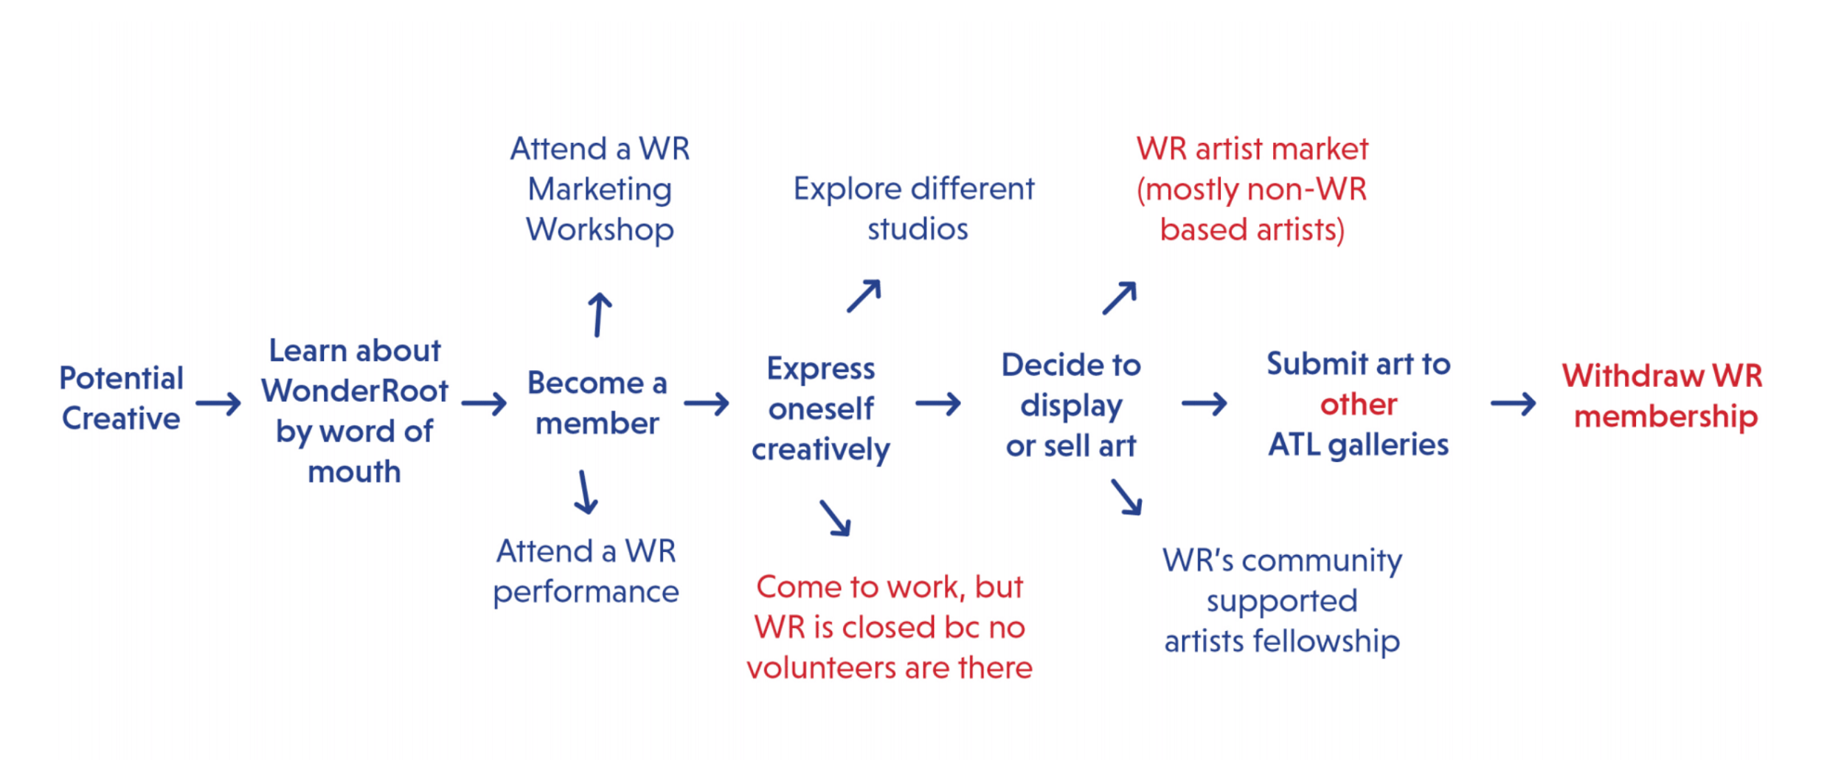
Defining The Issues from User Point of View
Notes:
This study revealed to us the perceptions held by our target audience that are preventing them from further participating in WonderRoot.

Slide 4
Defining The Issues from User Point of View
Creatives need a strong internal community
There is a creative divide members vs. vendors
“WonderRoot is a venue”
Notes:
The students’ assessment of this creative divide reaffirmed our need to clarify and enhance the ways one can get involved with WonderRoot.
Artist members vs. culture seeker members-- easiest to plug in as artist member, but there is still an audience who want to engage with WonderRoot through other means.
Lack of connectivity among members-- benefits for an individual but lacking benefits for a community.

Slide 5
Ideating Possible Solutions...
Creatives need a strong internal community
Member Portal
Weekly/Monthly Featured Artists/Members
There is a creative divide members vs. vendors
Member’s Only Artists Market
“WonderRoot is a venue”
Brand reflective of WonderRoot’s spirit

Slide 6
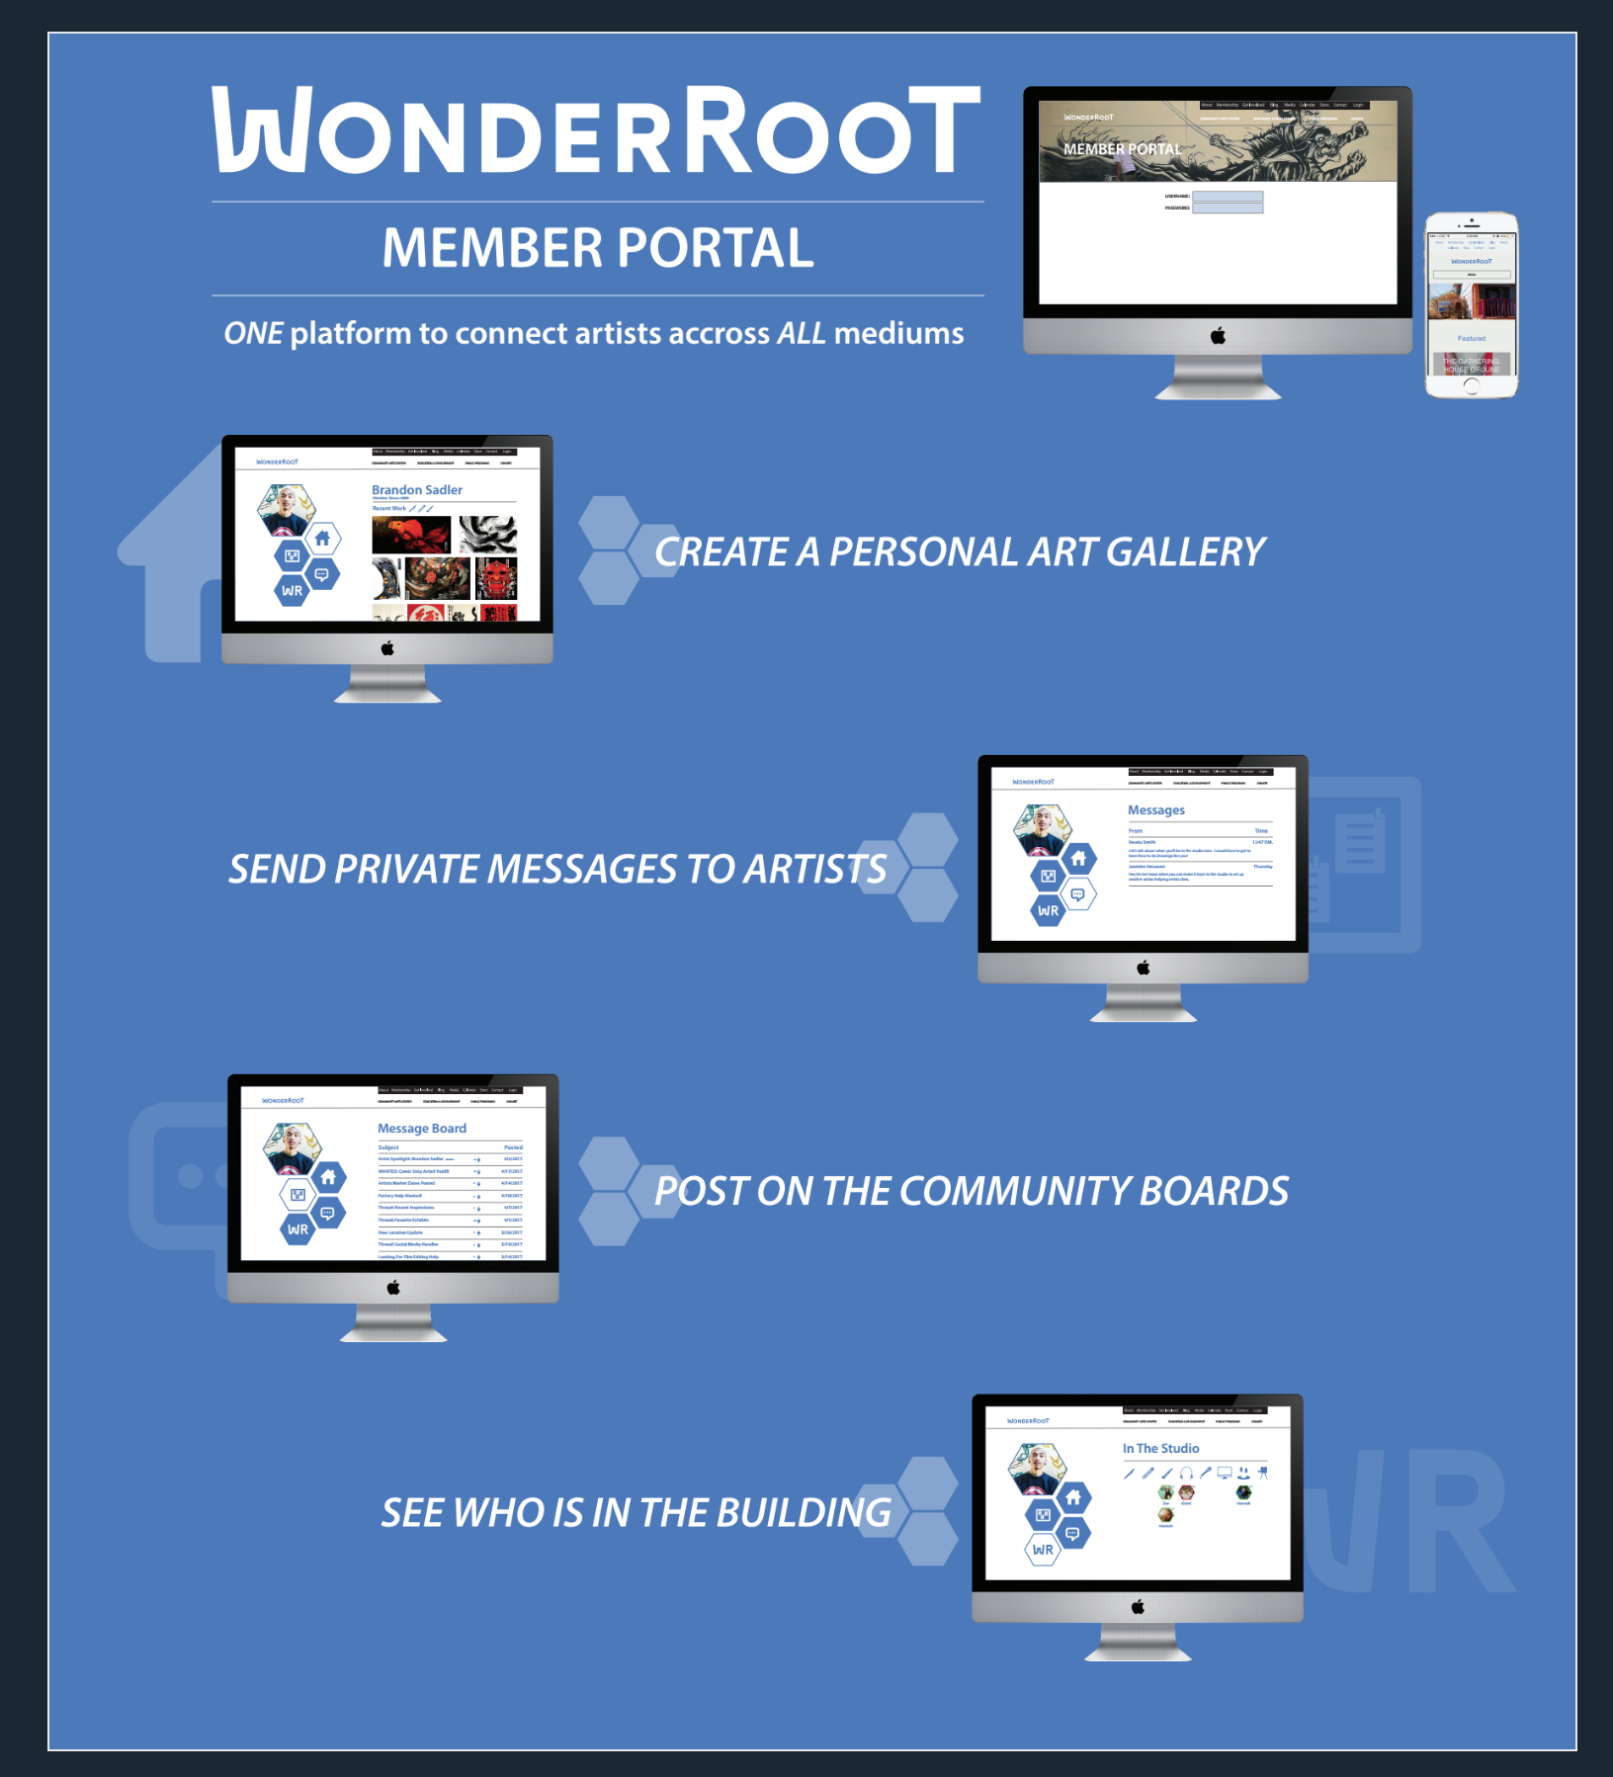

Slide 7
What Did WonderRoot Do with the Information?
This study revealed to us the perceptions held by our non-artist target audience that are preventing them from becoming members.

Slide 8
Results of the Work

Slide 9
Results of the Work
Strategic Plan Initiative 2.3: Attract and highly engage arts enthusiasts, artists, and a diverse community of local stakeholders related to arts and social change.
Internally define the different avenues through which someone can get involved with WonderRoot
Communicate and make available

