Slide 1
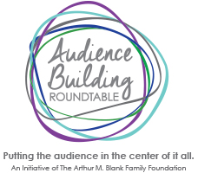
IAMO4W
An Audience Building Experiment

Slide 2
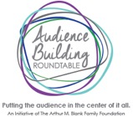
QUESTION
Can the theatre become a vital part of the community by engaging deeply, thus succeeding at building audience, donors, advocates and community?

Slide 3
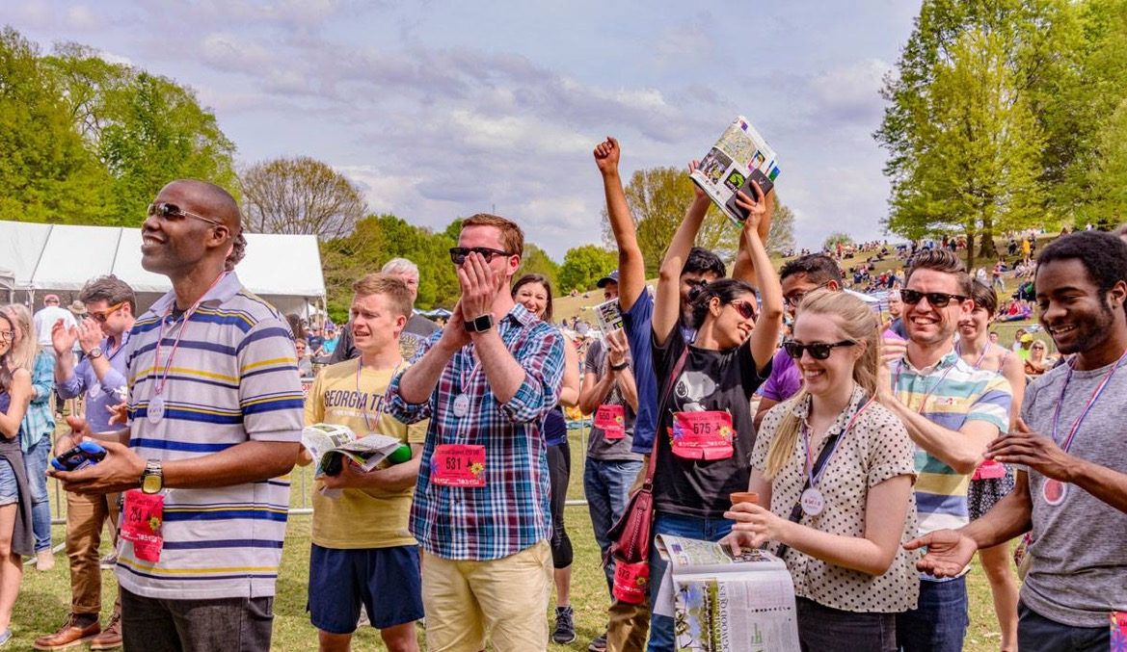
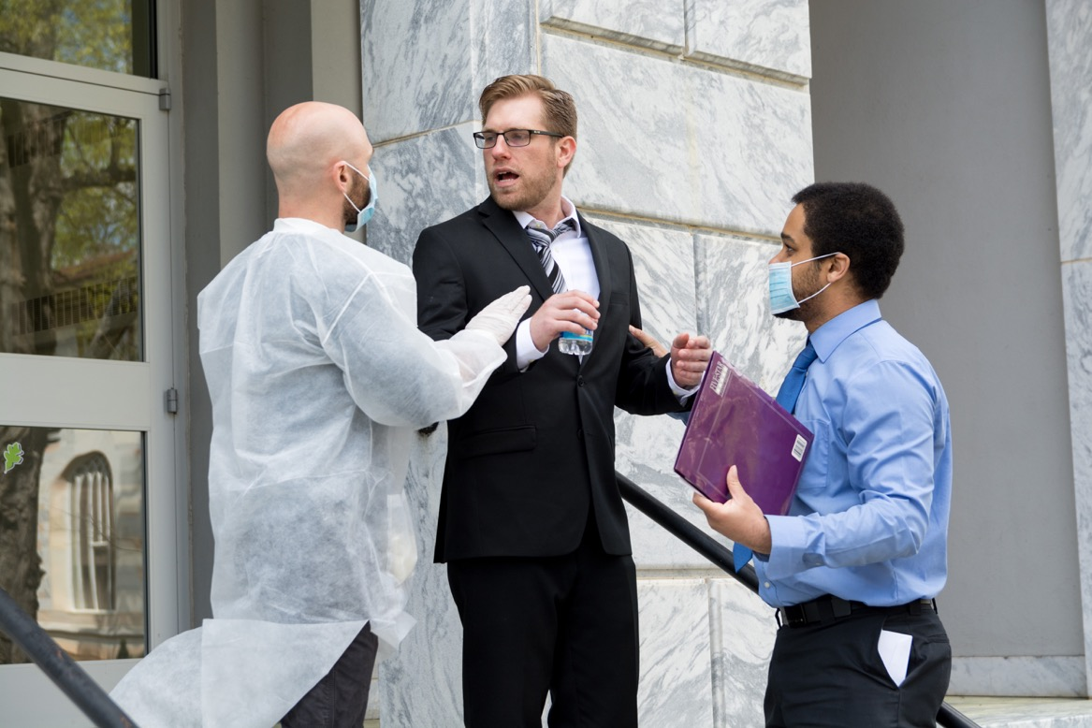
HISTORY
No Home: Bring Art to People Where They Are
Festivals, Schools, Attractions

Slide 4
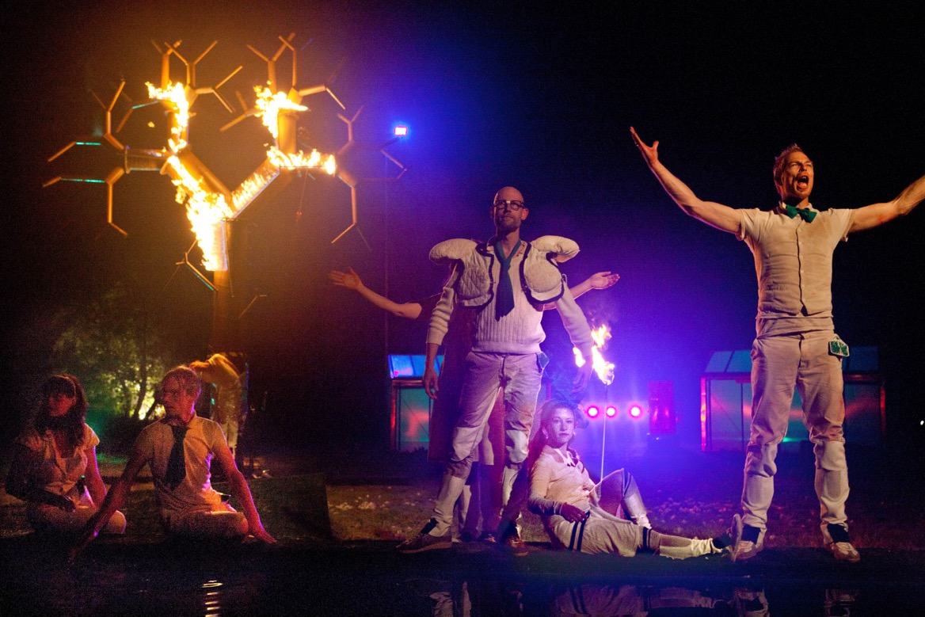
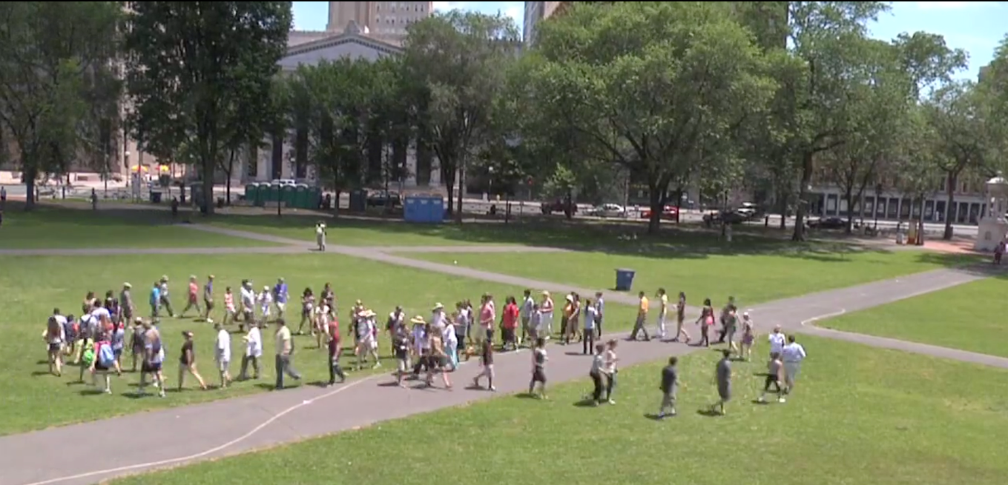
HISTORY
National & International Focus
Low Brand Recognition = Lost Audience Building Opportunities

Slide 5
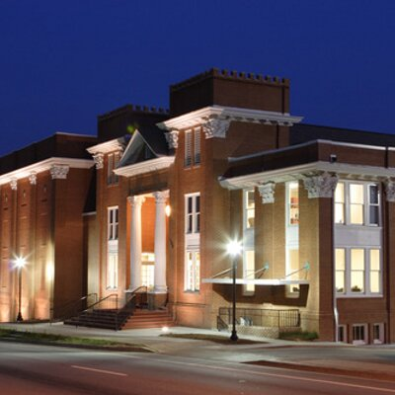
MODEL
Aurora Theatre
Companies that make a big investment in a specific community become vital, whereas smaller, scrappy companies like ours continually fight to show up through the marketing noise.

Slide 6
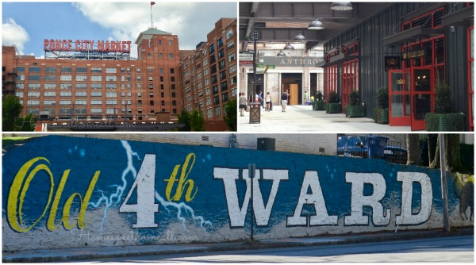
NEIGHBORHOOD
Old Fourth Ward
Historic and Trendy
Rich and Poor
Diverse and Segregated
Notes:
Home to King Center, MLK’s birth home, Ebenezer, Ponce City Market, Beltline Eastside Trail, Largest Section 8 public housing in Southeastern United States, real estate boom. Historically black neighborhood experiencing rapid gentrification.

Slide 7
PLAN
Conduct personal interviews with stakeholders in O4W
Discover needs, concerns, hopes, and fears
Devise a playbook of artistic responses to the civic needs, with a team of artists
Use that plan to guide programming in the upcoming years
Notes:
Out of Hand dived deep into The Essential Journey of Audience Building by seeking to understand the unique points of view and needs of potential audience members through personal interactions with our neighbors

Slide 8
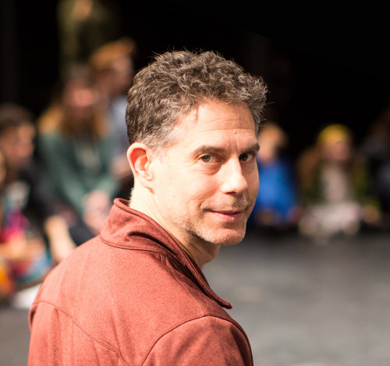
CONSULTANTS
The Center for Performance and Civic Practice
A national resource for artists and communities working together for arts-based, community-led transformation
Michael Rohd of Sojourn Theatre
“With the right approach, the same tools and capacities that artists use to make art can be utilized to transform systems and improve the impacts of government and community-driven efforts and programs.”

Slide 9
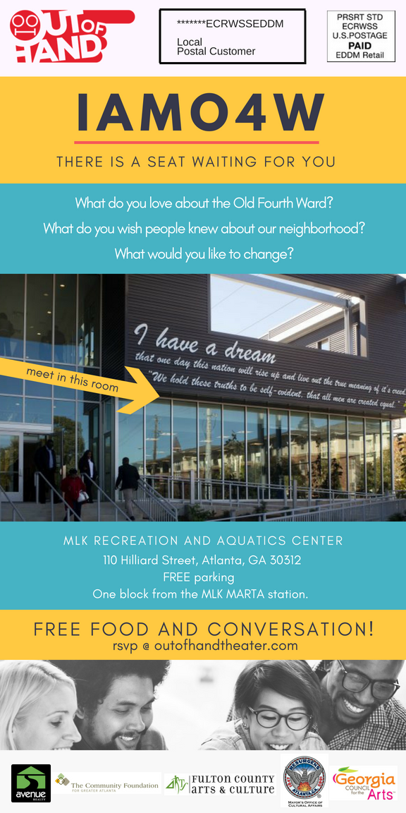
DESIGN
IAMO4W
An interactive, data-gathering community meal, designed by artists
Invitations sent to every household in O4W via Direct Mail
Notes:
btw – The “auditorium” is $50 per hour for non-profits. Well equipped with A/V, a prep kitchen, and a great staff

Slide 10
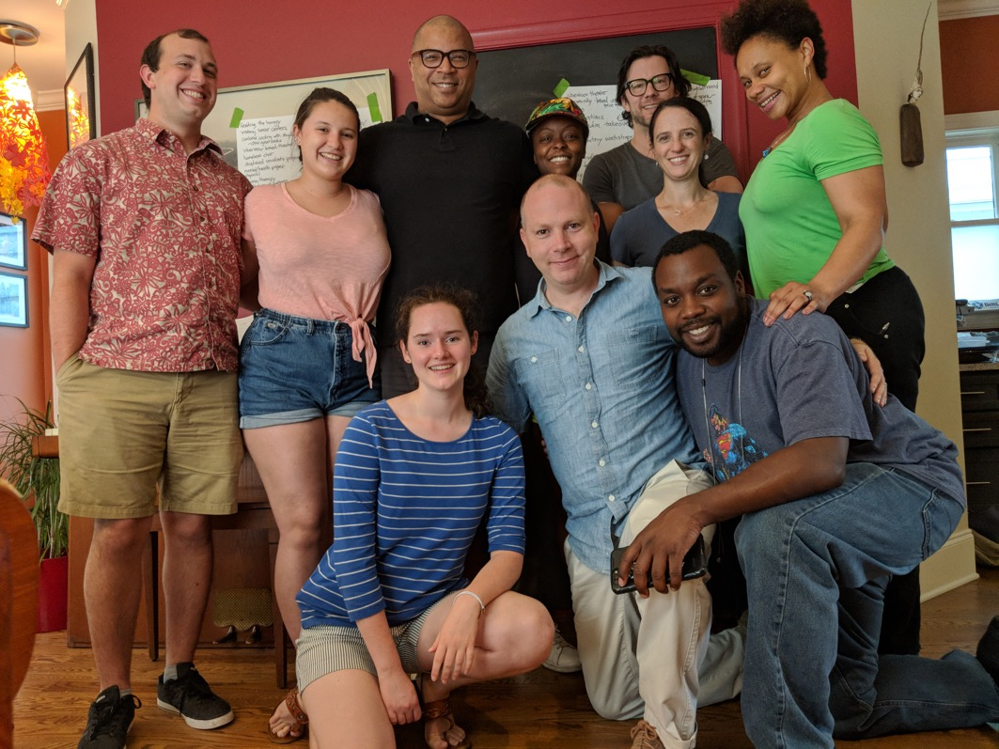
ARTISTS
Michael Winn
Danielle Deadwyler
Ariel Fristoe
Minka Wiltz
Adam Copeland
Enoch King
Emory Interns: Adam Friedman, Jessica McKeown, Julia Byrne
Not pictured: Andrea Washington
Notes:
These artists designed the event and developed program ideas responding to the data afterwards

Slide 11
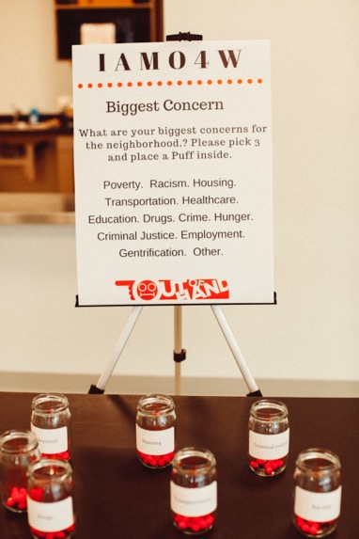
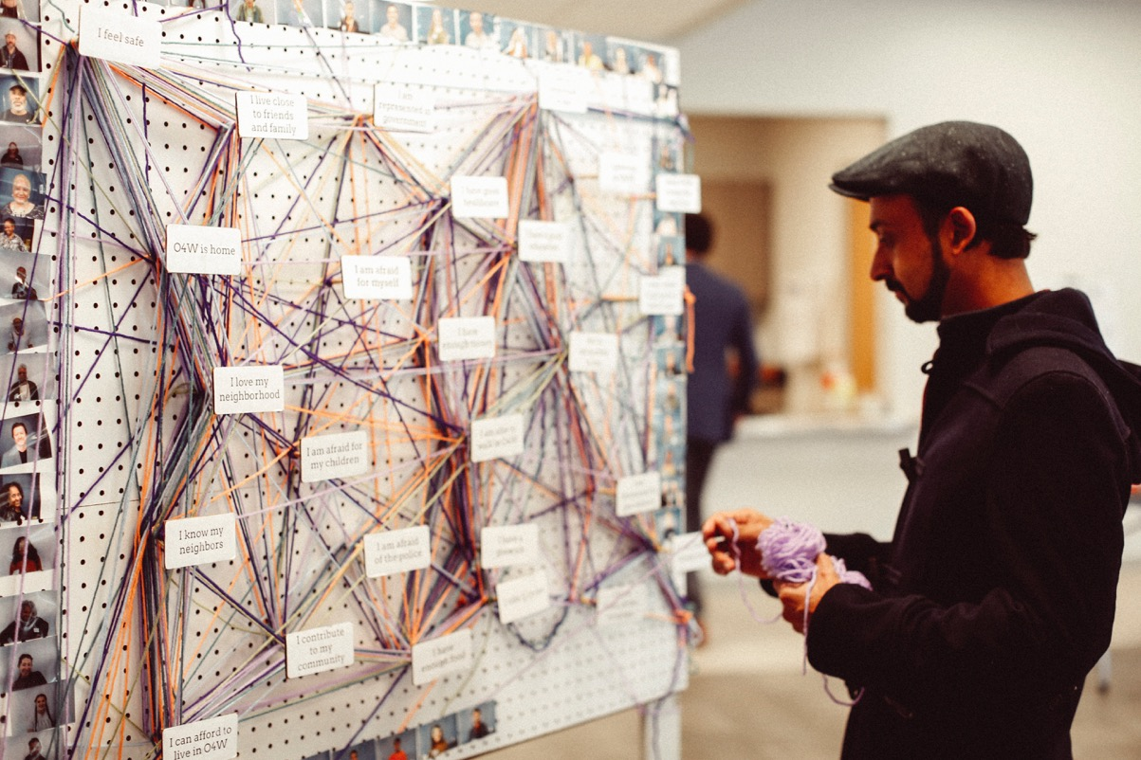
DATA COLLECTION
Identity Wall
Top Concerns Jars
Love/Promote/Change Ballot
Audio Collection

Slide 12
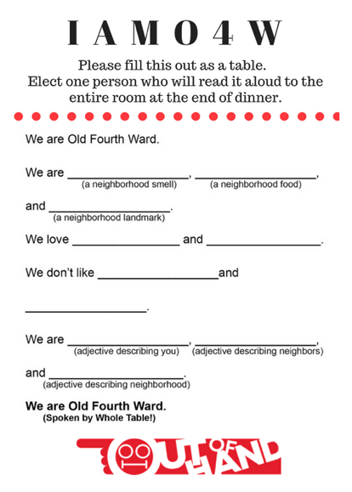
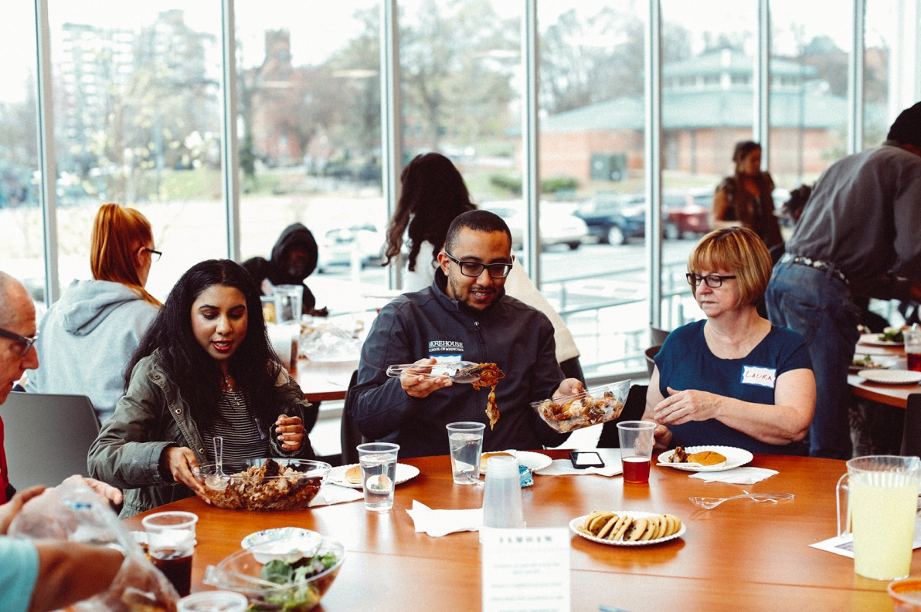
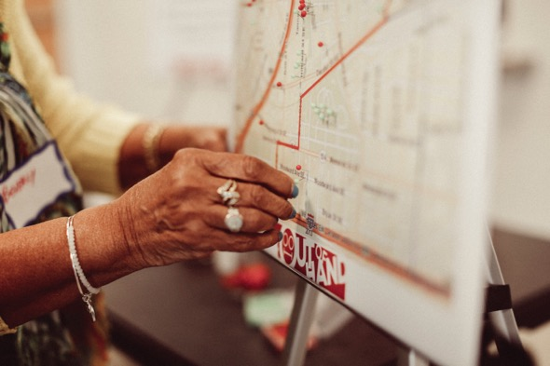
DATA COLLECTION
Best and Worst Places Map
Moving Survey
Madlib Poem Table Tents
Written Survey

Slide 13
RESULTS: History and Housing
What Do You Wish People Knew About O4W?
Top Concerns
Housing
17%
History
27%
Poverty
12%
Notes:
IAMO4W revealed a strong desire to promote the rich history of the neighborhood, and a deep concern over affordable housing, as rising housing costs drive historic residents out, threatening to change the character of this historic neighborhood forever. History was the number one thing response to the questions, “What do you wish people knew about O4W?”, with 27% of responders citing it. Housing was the top neighborhood concern, with 17% of responders choosing, and poverty was the 2nd concern, at 12%.
Not pictured here: In addition, 29% of responders cited gentrification or affordability as the thing they would most like to change about the neighborhood.

Slide 14
RESULTS: Arts Participation
Most Listed Sources
Radio: NPR/WABE, V103, 104.1
Social Media: Facebook, Instagram, Twitter, Reddit
Neighborhood Email Lists
Creative Loafing & Atlanta Planit
Notes:
Barriers and Preferences for Participation in the Arts

Slide 15
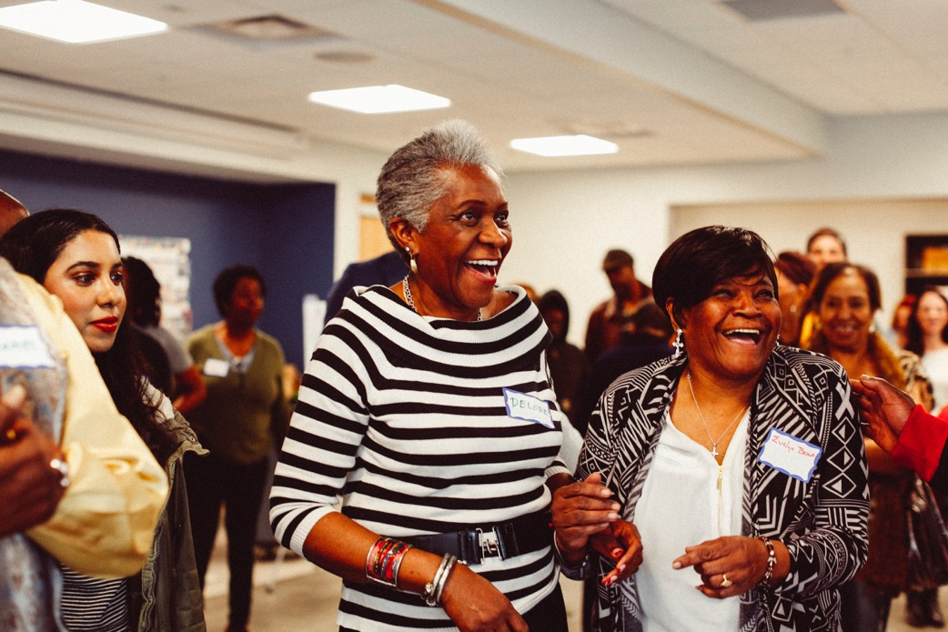
RESULTS: Community Building
Profound Effects
Wildly Diverse Audience
Positive, Meaningful Interactions Between Neighbors
Joyful Spirit of Community
Living Room Series Hosts
Volunteer Photographer
Notes:
Audience: homeless and wealthy, black and white, grew up in neighborhood and just moved in. The event itself built community, in addition to the projects we will develop based on the data we gathered. Neighbors who never speak had meaningful interactions over a shared meal. Neighbors voiced concerns, priorities crystallized, and strangers became friends. STW hosts: Lynne Alston-Leonard co-hosting with Jordan Flowers.

Slide 16
RESULTS: Community Building
Community Building Opportunities
Giving Voice to Our Youth Conference
National Divine Spiritual Church/ Baha’i Center/ Collaboration
Blaze Leadership Introduction Activity
Friendships
Neighborhood Influencers and Mavens, Businesses, Houses of Worship, Senior Centers, Service Organizations
Notes:
Giving Voice to Our Youth: free youth conference to uplift and empower 300 future leaders in Southwest Atlanta
Baha’i Center/ NDSC: story sharing/open mic event for neighborhood’s homeless
Blaze Leadership: theater games-based interactive company intro for conferences

Slide 17
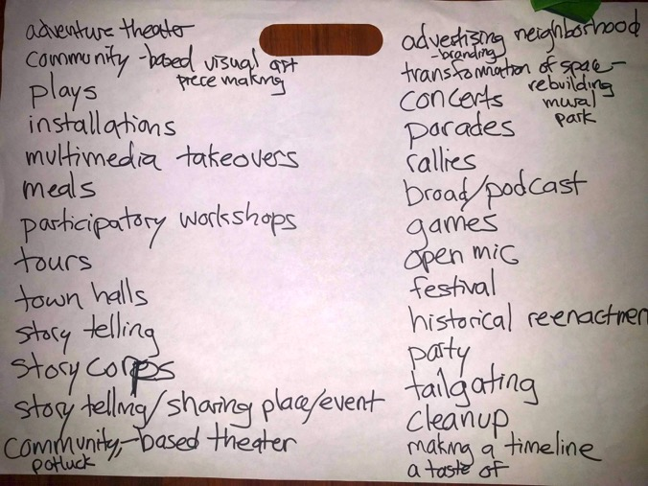
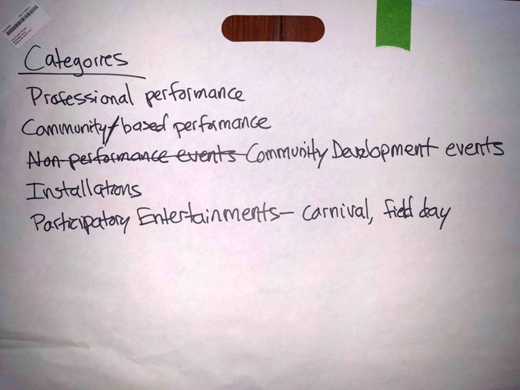
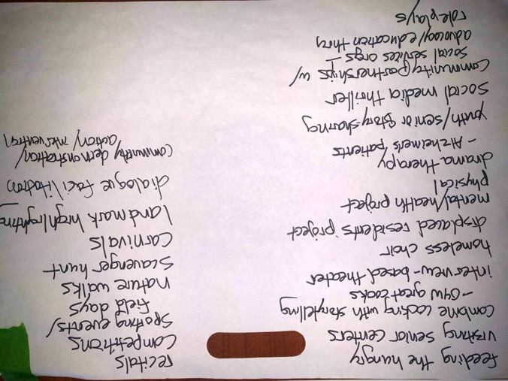
PROGRAM IDEAS

Slide 18
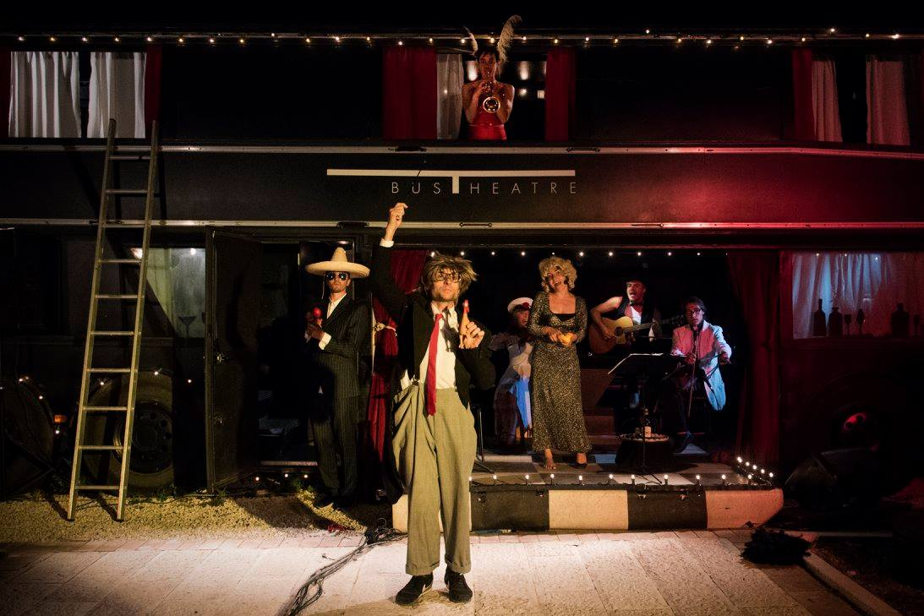
THEATRE BUS
Double-decker bus serving as mobile outdoor stage, intimate performance space, and community center
Theatrical tour of MLK Historic District focusing on history and housing, the past and present and future
Notes:
850,000 people visit the Martin Luther King Jr. Historic Site each year, no performance offerings about MLK District in neighborhood
A living billboard with high value as a social media share. open mic nights; traveling music, theatre and art events; and portable educational theatre installations,
Engage with museums, festivals and attractions to deliver pop-up performance events that enhance their offerings and build audience.
Theatre Bus addresses top neighborhood issues of history and housing, and top barriers to arts participation: schedule, cost, location, by being highly nimble in all 3. Plus it’s a community symbol, community gathering spot and revenue generator. This pic is Bus Theatre in Italy, also based on models of Magic Bus in San Francisco and RideNYC

Slide 19
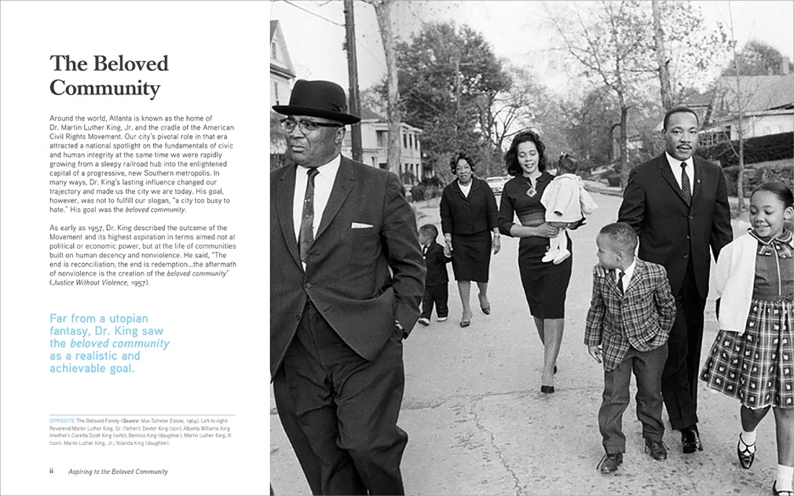
BELOVED COMMUNITY
The Atlanta City Design Aspiring to the Beloved Community
“Atlanta’s contribution to the world is the legacy of the Civil Rights Movement, the promise of which describes a city built for everyone.”
Notes:
The Atlanta City Design, published by the City of Atlanta Department of City Planning, boldly proclaims Atlanta’s intent to become The Beloved Community Dr. King spoke about. Atlanta is famous around the world as the home of Dr. King and the cradle of the Civil Rights Movement. Out of Hand is based in Dr. King’s own neighborhood. We will use our skills as artists to work with our neighbors to build the Beloved Community, to build audience for the arts, and to make artists vital to our community.

Slide 20
THANK YOU!
Out of Hand Theater Adam Fristoe Co-Artistic and Marketing Director adam@outofhandtheater.com www.outofhandtheater.com @OutofHandATL

