Slide 1
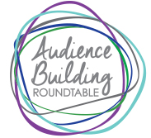
Audience Building Innovation Grant Report July 2018
An Initiative of The Arthur M. Blank Family Foundation

Slide 2
Typical Season:
ALLIANCE SERIES: 4 productions in 770-seat mainstage
HERTZ SERIES: 3 productions in 200-seat black box
THEATRE FOR THE VERY YOUNG: 3-5 productions
THEATRE FOR YOUTH & FAMILIES: 3 productions
50th Anniversary Season
150,000+ Patrons
350 Performances
100 Full-time Staff
~$14m Annual Budget
2007 Regional Theatre Tony Award
About the

Slide 3
ANNUAL REVENUE 50% Earned 50% Contributed
EARNED REVENUE
Single Ticket Sales: 70%
Subscriptions: 30%
4-play Alliance/Mainstage (3,500 @ $156/avg)
3-play Hertz/Black Box (1,596 @ $68/avg)
Choose Your Own (CYO) (1,397 @ $65/avg)
CONTRIBUTED REVENUE
Individuals: 33%
Corporations: 33%
Foundations: 33%
About the

Slide 4
Why Change? Why Now?
During the 42nd Season, Alliance Theatre leadership and Board started to think about what the Theatre could mean to the community at 50 and beyond
It took 3 years to formulate the plan
2.5 years to raise the additional money needed to change
1.5 (ish!) years to build the new theatre
About the

Slide 5
Brand New Coca-Cola Stage at the Alliance Theatre
In January 2019, after the completion of a $30+M complete reimagining of the space, the new Coca-Cola Stage will open
The more intimate 650-seat theater will feature a one-of-a-kind sculptural design, vastly improved acoustics/sight lines, and transformed rehearsal, education, and artist support spaces, including a completely new costume shop
To complete the renovation, the Mainstage and Black Box were completely unavailable for 2017-18 season
But where did we perform during construction?
About the

Slide 6
12 Shows in 13 Unique Venues

Slide 7
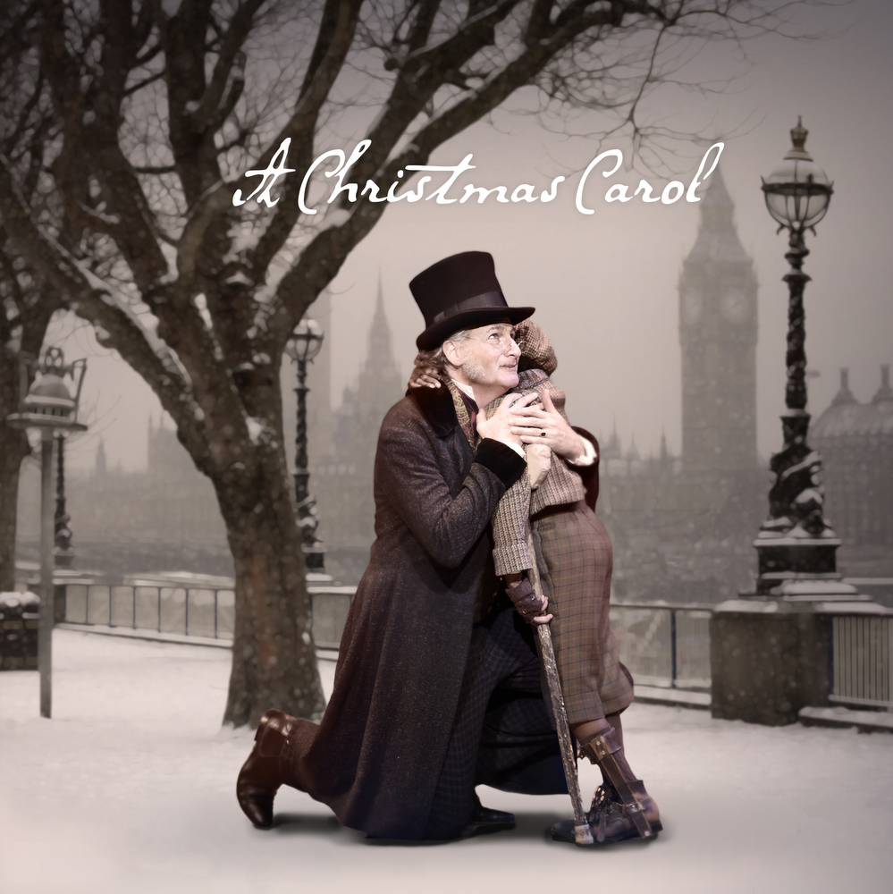
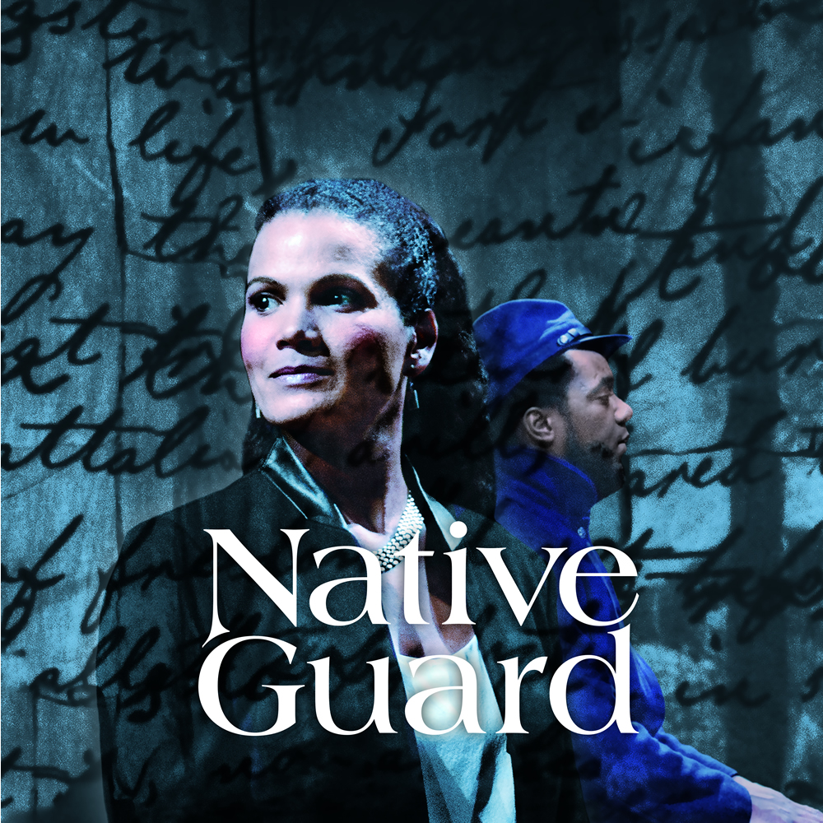
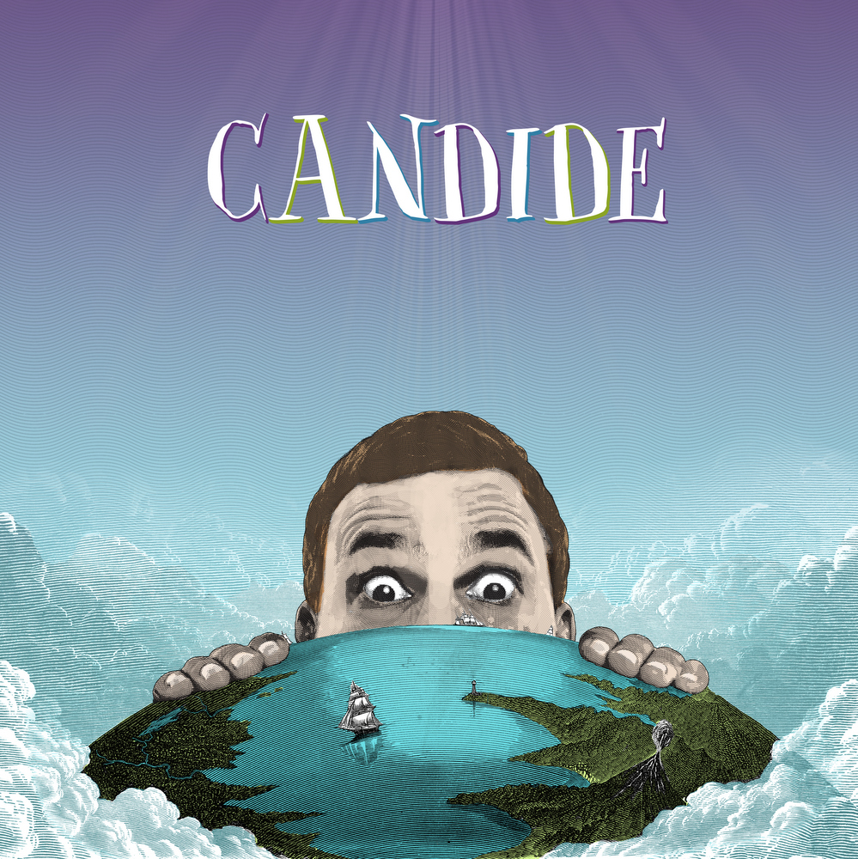

Slide 8
THE QUESTION(s):
How do we want to change the organization to be ready for a new venue, an ever-changing city, and a new half-century of patron development?
Can we take advantage of this unique off-campus season to attract new patrons?

Slide 9
THE PARTNER(s):
TRG Arts- funded through an Audience Innovation Grant from the Audience Building Roundtable
Alliance Theatre Board of Directors- multiple organizational, financial, and retail consultants volunteered services and counsel
The Woodruff Arts Center- designed a campus-wide capital & endowment campaign around the Alliance project

Slide 10
THE GOAL(s):
New Patron Acquisition
Patron Retention
Brand Awareness
Simplified Patron Development
Streamlined Organizational Structure and Process

Slide 11
THE TIMELINE:
5 Seasons Challenge
47th Season: Initial Planning & Staffing 48th Season: TRG Arts Data Analysis & Business Model Reconstruction
49th Season: On the Road- Brand Building and Patron Experience
50th Season: Acquisition, Retention, Anniversary Celebration
51st Season: New normal- positioning for future growth
Audience Innovation Grant Period

Slide 12
THE CASE STUDY:
Drivers of effective practices
Contributing factors to success in Audience Building
Results Analysis

Slide 13
“We want to go around town, make new friends, and bring them back to campus with us.”
-Jessica Boatright Director of Marketing
“If we can get outside this building and re-introduce ourselves to the city, we might allow other people to see us, making it easier for them to get in the door by making the door slightly more visible.” -Donya Washington Off-Site Season Producer
Staff Interviews

Slide 14
Investigated Causes:
Frequency of visits
Tenure
Price
Subscription vs. single-ticket buyers
Number of tickets bought
Distance from venue
Donor status
Seasonality
Day of Week
Programming
2008 Oliver Wyman study of large orchestras: 80%+ first-time buyers don’t return
Headwinds: Churn

Slide 15
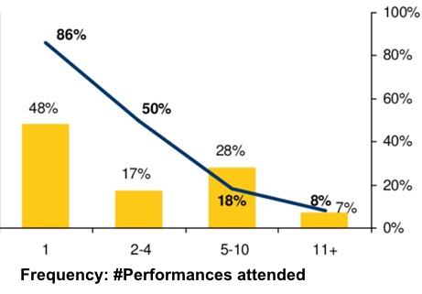
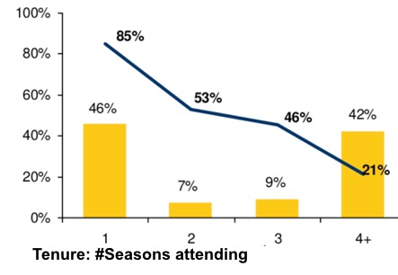
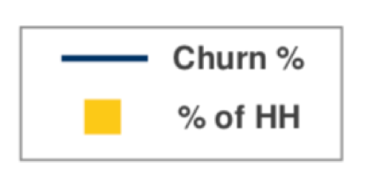
Clear Implications
⇑ Frequency ⇑ Tenure
Oliver Wyman, Turning First-Timers into Life-Timers: Addressing the True Drivers of Churn (New York, NY: Oliver Wyman, 2008)

Slide 16
Primary Drivers: 1) Entertainment/fun
2) Learn/see something new
3) Educate myself/my family
From our 2017-18 Brand Awareness Study by Alexander Babbage
Primary Barriers: 1) Too busy/lack of free time
2) Cost/too expensive
3) Not interested
Primary Competitors: 1) TV/Netflix
2) Listen to music/podcast 3) Spend active time outdoors
Consumer Trends

Slide 17
CHALLENGE(s):
How do we change our organization to reduce churn & encourage higher frequency?

Slide 18
Data-Driven Marketing Strategies
Maximize Revenue Per Seat
Identify ticket sales patterns and re-scale the house
Release the house in waves
Less reliance on comps and discounts
Resource Allocation:
marketing spend
department structure
Audience Growth Through Retention
Make first visit the start of a long relationship (First, build frequency)
Encourage newcomers through engagement events, education programs
Convert multi-ticket buyers and “Choose Your Own” subscribers to full subscribers
Reactivate lapsed subscribers
Increase first-year renewal rates (45% vs. 90% for other subscribers)

Slide 19
PRODUCTION-SPECIFIC EVENTS
100+ pre- and post-show events
PRODUCTION-SPECIFIC TEAMS
12 Teams consisting of Board & Advisory Board members and staff focused on each location to invite, attend, and support
Engaging Newcomers
Cross-promotions
Collaboration with venue partners, for example:
Participation in community / partner events
Shared promotions / discount codes
Production – specific engagement events
Camps/Education Programming
In advance of 2017/18 Season, piloted Satellite Summer Camps in 5 off-site locations
Alliance Theatre Institute in each off-site community

Slide 20
MEASURE(s):
What are the trends in our audience, and how did the off-campus season affect these trends?

Slide 21
Total Audience, Single Ticket and First-Time Patrons Down 25%* in Off-Campus Season
(*with 1 mainstage show yet to be performed)
5,000
1,500

Slide 22
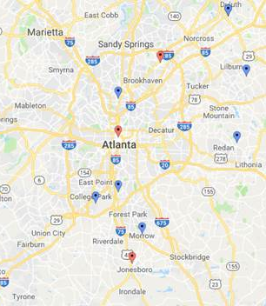
Geography
338 zip codes for single ticket buyers in both 16/17 and 17/18
93 zip codes had single ticket buyers in 16/17 but not in 17/18
56 zip codes had single ticket buyers in 18/19 but not in 17/18
Little change inside ATL zip codes

Slide 23
MEASURE(s):
What are we doing to improve retention?

Slide 24
Retention Strategy: Secure a “Second Date”
Typical cadence:
First touch—email: “Thank you for attending Shakespeare in Love! We noticed this was your first time attending Alliance Theatre. We hope you had a great time and we'd love to see you back! Save 50% off your next show when you purchase by October 29. Don't let this incredible offer pass you by - order your tickets TODAY!”
Reminder postcard one week after end of run
Email the following week
Postcard 10 days later
All first-time attendees sent offer to return for another show that season at 50% off (first time ever) or 30% (first time this season).

Slide 25
Retention Strategy: Secure a “Second Date”
 | Offered | Response | Tickets Sold | Dollar Value
First Time Ever (50% off) | 6,546 HH | 130 HH (2%) | 347 | $8,204
First Time This Season (30% off) | 4,296 HH | 192 HH (1.9%) | 192 | $6,345

Slide 26
Reactivate Former Subscribers
OFFER: Renew Your Prior Subscription
Faux Renewals (Lapsed in prior year)
1,140 HH targeted
101 (8.8%) purchased subscriptions
2-5 Year Lapsed Subscribers
1,754 HH targeted
37 (2%) purchased

Slide 27
Convert Multi-Ticket Buyers to Subscribers
OFFER: Upgrade to a Subscription
Choose Your Own (self-designed package of 3+ shows)
158 HH targeted
49 (31%) purchased subscriptions
Multi-single Ticket Buyers (High-frequency non-subscribers)
1,408 HH targeted
19 (1.3%) purchased

Slide 28
New Subscriptions Up, Renewal Rate Increases
64% 57% 74%
2015/16 | 2016/17 | 2017/18 |  |  | 2015/16 | 2016/17 | 2017/18

Slide 29
MEASURE(s):
How are we improving our processes and practices to streamline and bring greater efficiency?

Slide 30
Practices Cutting into Per-seat Revenue
Price did not increase as supply decreased (Dynamic Pricing)
Reactive reliance on discounts & comps to fill houses to create “perception of success” (aka- full house at any cost)
History of comping up to 60% of seats for the slowest-selling Mainstage shows, and up to 80% for languishing Black Box shows
Solutions:
Rescale houses according to actual demand
Release single tickets in “waves” or “zones” to fill houses from front, creating a better patron experience

Slide 31
Ticket Inventory Management
Four Zone-releases in largest spaces-- all price points available in each zone
Houses appear fuller
Easier to manage front-of-house when shows fill from front
Greater ability to adjust pricing in response to demand
Good seats available at low price point—not just rear upper balcony
NEW CHALLENGES:
Transparent communication to patrons so they don’t assume shows are sold out because a new zone hasn’t been opened
Using 12 houses that were not our own

Slide 32
Simplifying Pricing
Before the Alliance worked with TRG Arts through the Audience Innovation Grant, single ticket buyers had 50 potential price points…to start with.
Now they have 12.
Scaling houses to better reflect and respond to demand
TRG Recommends moving from four different scalings to one.
We’re not convinced…

Slide 33
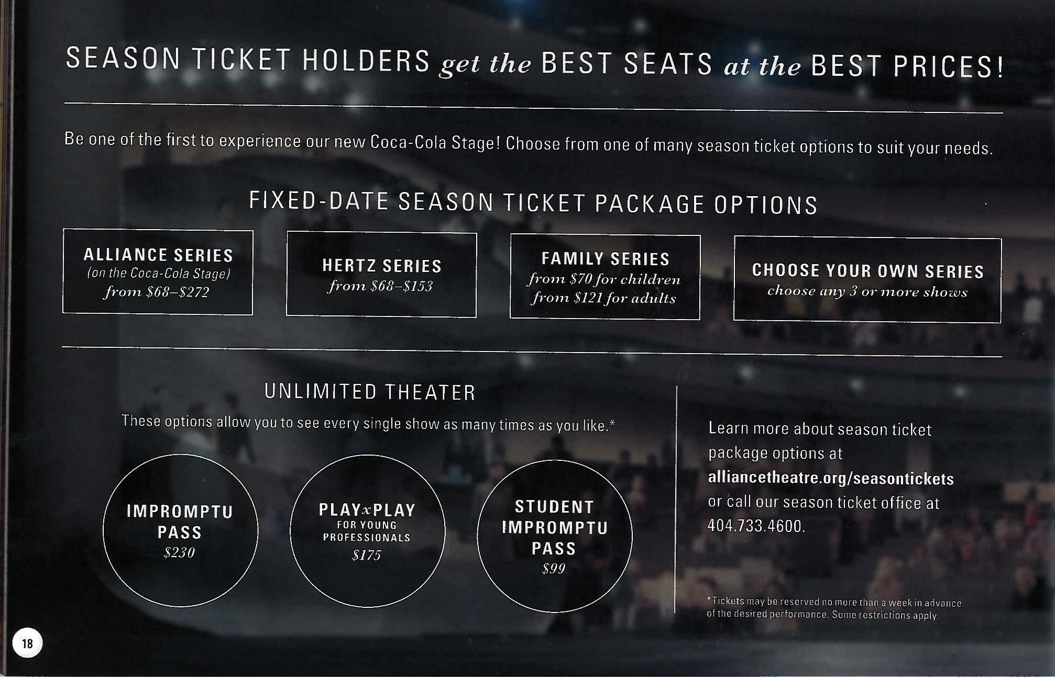
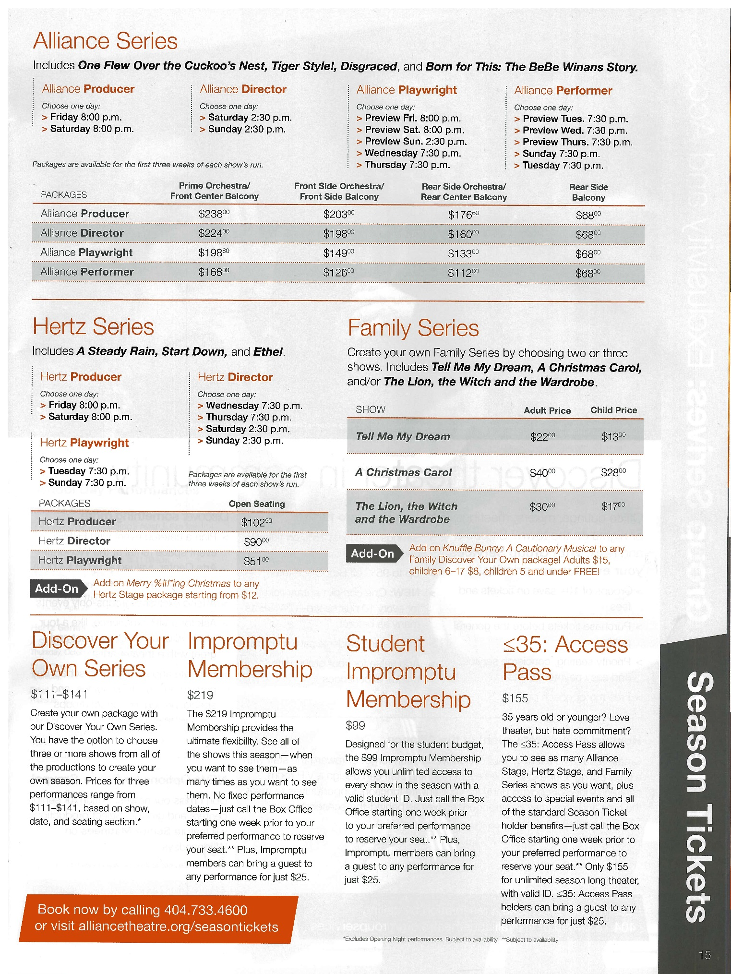
BEFORE
AFTER

Slide 34
Using Comps and Discounts (more) Strategically
Discount early, not late in sales ramp-up: reward early purchase
Audit Discount “creep”
Example: Seniors were given a surprisingly high discount for subscriptions
Tickets for Teachers
Teachers with a valid ID receive up to two (2) tickets for early shows
Build affinity with an influential group
Nearly 900 tickets distributed in 2017/2018
$10 Tuesday and Sunday Industry Nights for Atlanta actors and artists
Get out in front of low demand
Build affinity with an important group
These strategies require discipline so as not to return to old practices
From 16/17 to 17/18, we reduced the number of comps from 25,916 to 16,809

Slide 35
RESULT(s):
What are specific results from the off-site season?

Slide 36
Audience & Revenue Growth
More than 25,000 people visited the Alliance Theatre for the first time during On the Road season
48% of DANCING GRANNY attendees were brand new
35% of CHRISTMAS CAROL attendees were brand new – a new record
Highest revenue ever for A CHRISTMAS CAROL - $845,544
Cemented the student matinee program as a year-round program for public, private and homeschool groups with over 58 student matinee performances serving over 30,000 students

Slide 37
Audience & Revenue Growth
And the great news is that they are coming back!
Through a retention campaign aimed at first-time patrons, 455 tickets were sold to returning patrons who came back for ANOTHER show during the On the Road Season
Data tells us they are 2–3x more likely to come back again
Twice as many NEW subscribers for 2018/19 season as 2017/18
Best start for a season ticket campaign in 17 years
Distributed almost 900 Tickets for Teachers in 2017/18

Slide 38
PRACTICE(s):
What else have we done differently?

Slide 39
BE THE NEWS YOU WISH TO SEE IN THE WORLD
This year, the Alliance Theatre’s Content Team created
42 fully original videos, including: 8 venue videos & 10 production trailers
Video success of the year: The Ashley Bryan Story
210K people reached
91K video views
39,413 minutes viewed
7,303 reactions, comment and shares (1,209 shares)
ALL ORGANICALLY!

Slide 40
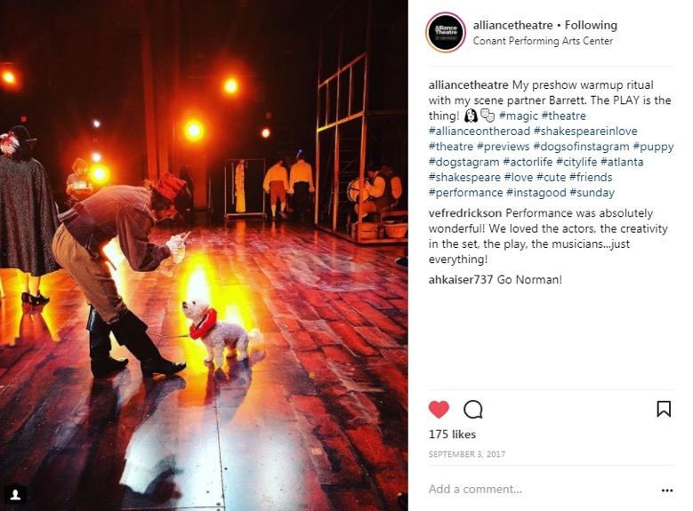
SOCIAL MEDIA GROWTH
Twitter up 4% over FY17
Facebook followers up 22%
Instagram is booming, proving to be our most valuable platform
37% follower increase over last year
(it was up 21% the year before)
15 Instagram takeovers this year
One of our favorites: Norman the Dog

Slide 41
RESULT(s):
What else about our bottom line has changed in this process?

Slide 42
CONTRIBUTED REVENUE 5-YEAR TRENDS
Annual Totals
FY14: $4,503,060
FY15: $4,469,210
FY16: $5,724,891
FY17: $6,120,893
FY18: $6,241,260

Slide 43
EMPLOYING BETTER DATA TO DRIVE NET PROFIT: DEVELOPMENT
Net Profit FY10: $2,664,775
Corporate Phil. Integration
Net Profit FY18: $5,167,260

Slide 44
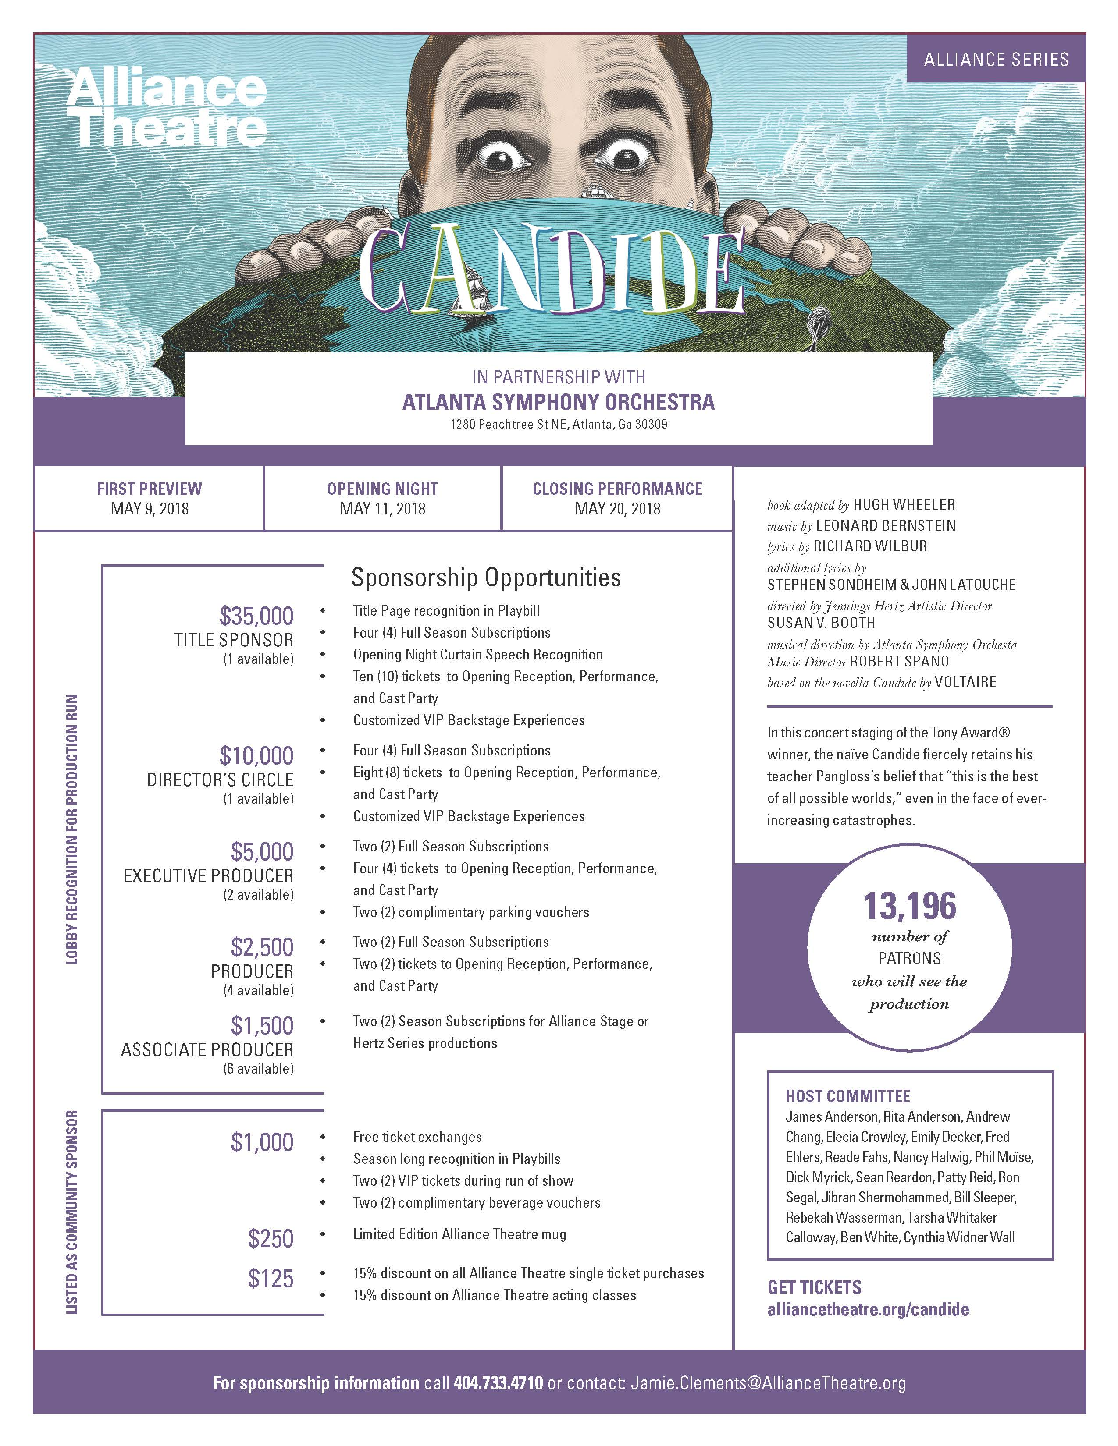
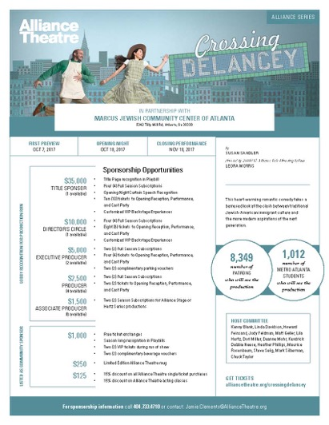
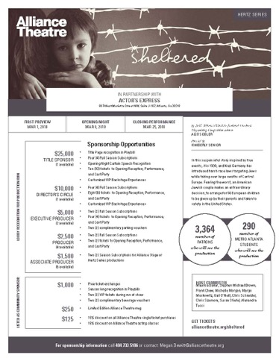
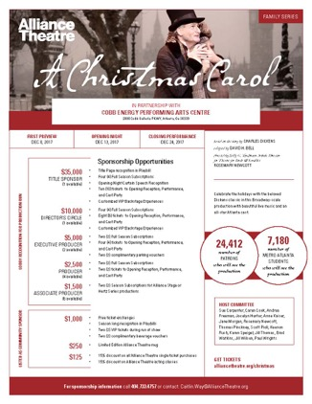
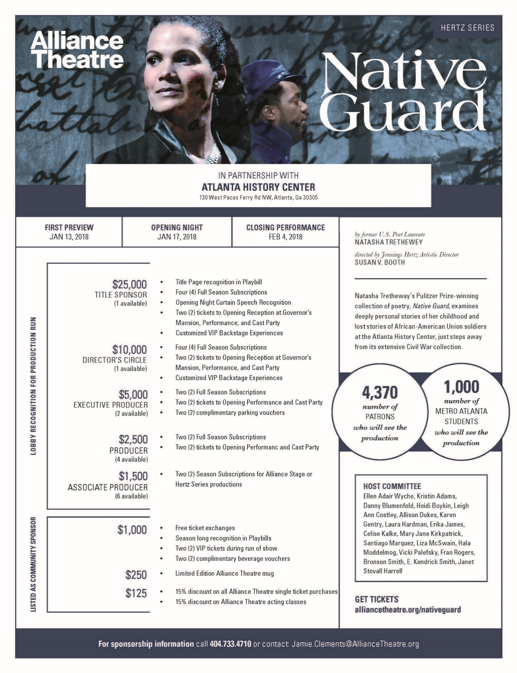
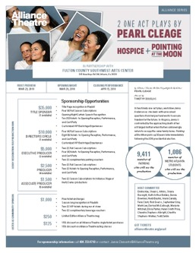
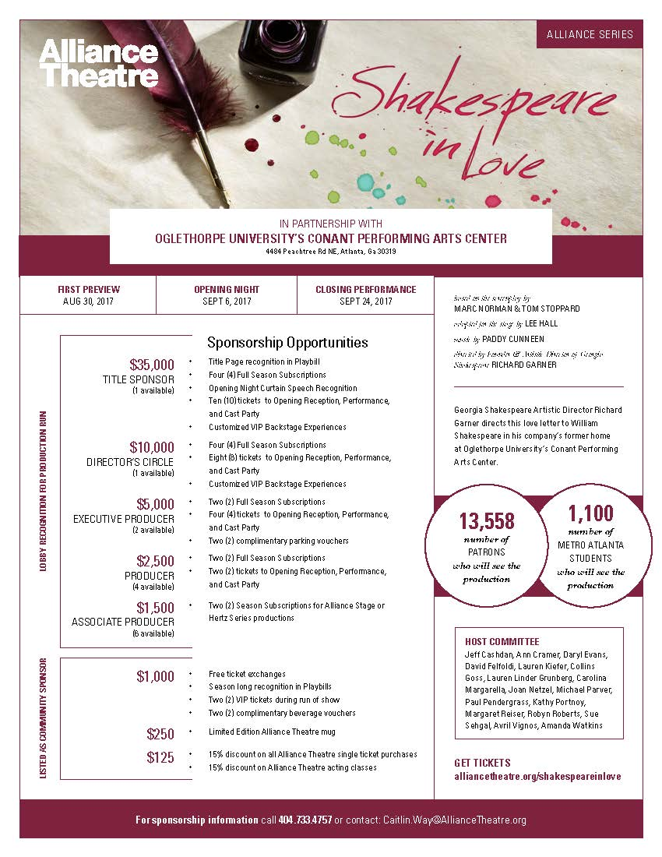
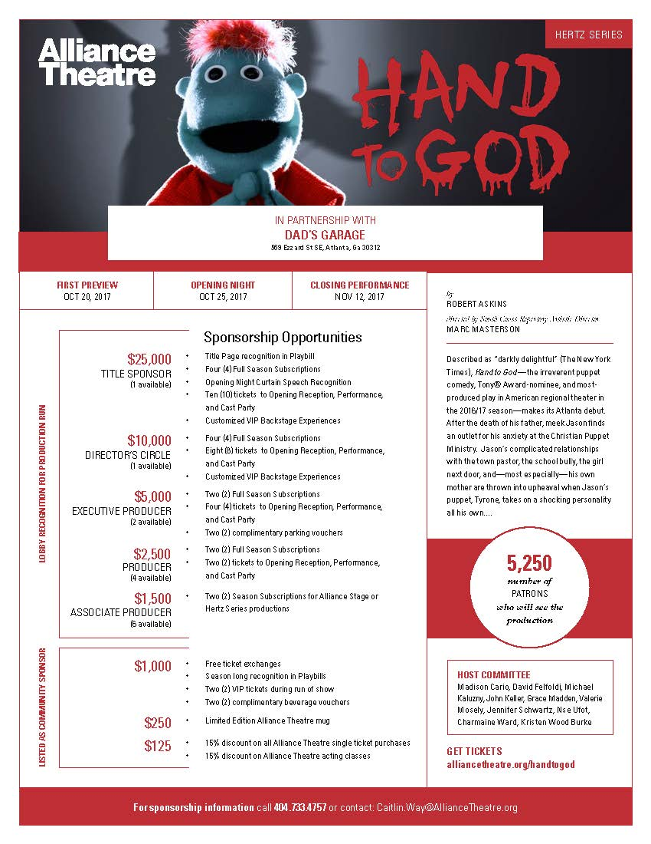
OFF-SITE TEAMS + DATA = $199,300 IN NEW SPONSORSHIPS
$10,000
$81,500
$25,000
$11,500
$10,500
$49,800
$8,500
$2,500

Slide 45
NEXT STEP(s):
What will we take away from our Audience Innovation Grant?
What projects are on the horizon for us to continue this process?

Slide 46
LEARNING(s):
What’s not measured is not managed
Change only gets harder with age and size (so don’t wait)
True, effective change is a long-game (with some short term gains)
Our board is our very best asset
Patrons notice and appreciate responsive, dynamic products
There are no substitutes for vision or engagement

Slide 47
COMING SOON(s):
Membership model(s)
Merged vertical(s) within Marketing & Development
Therapy and Adult Beverages
A new data consultancy…

Slide 48
See you soon at the (all-new)

