Slide 1
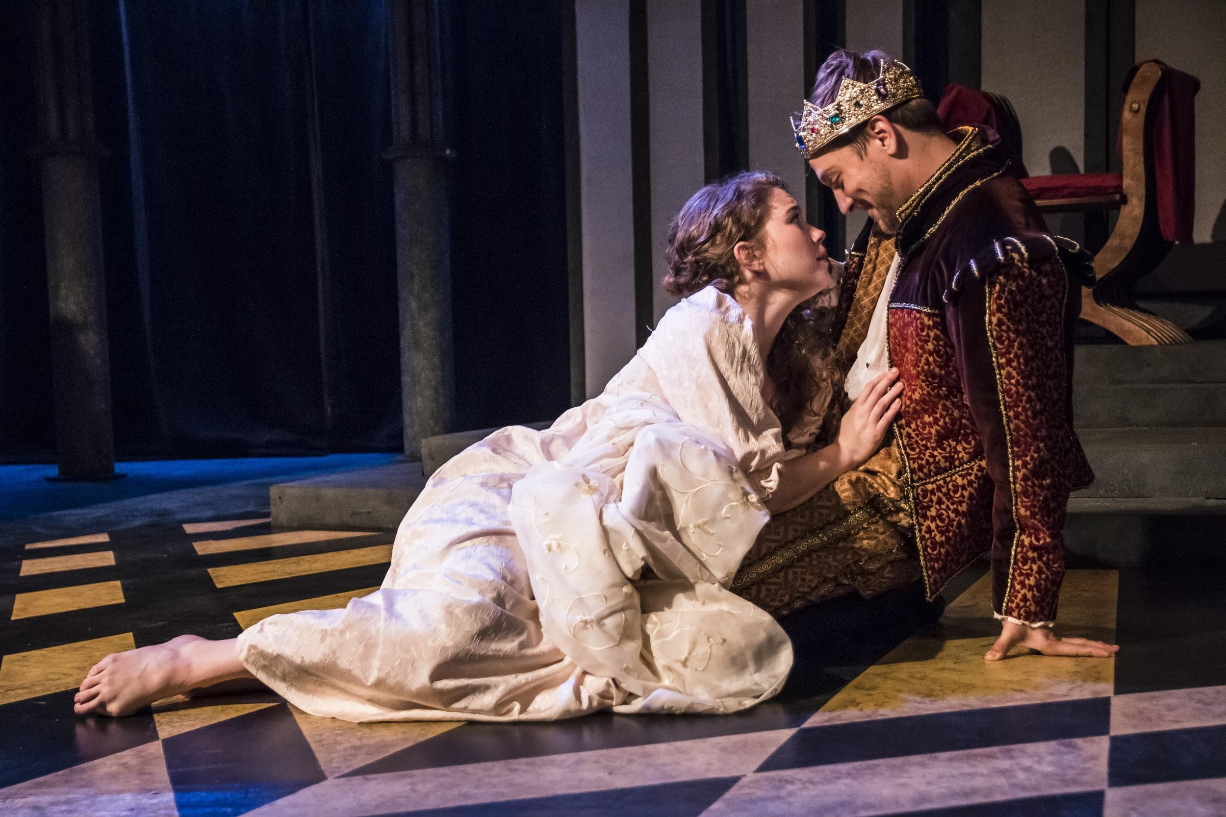
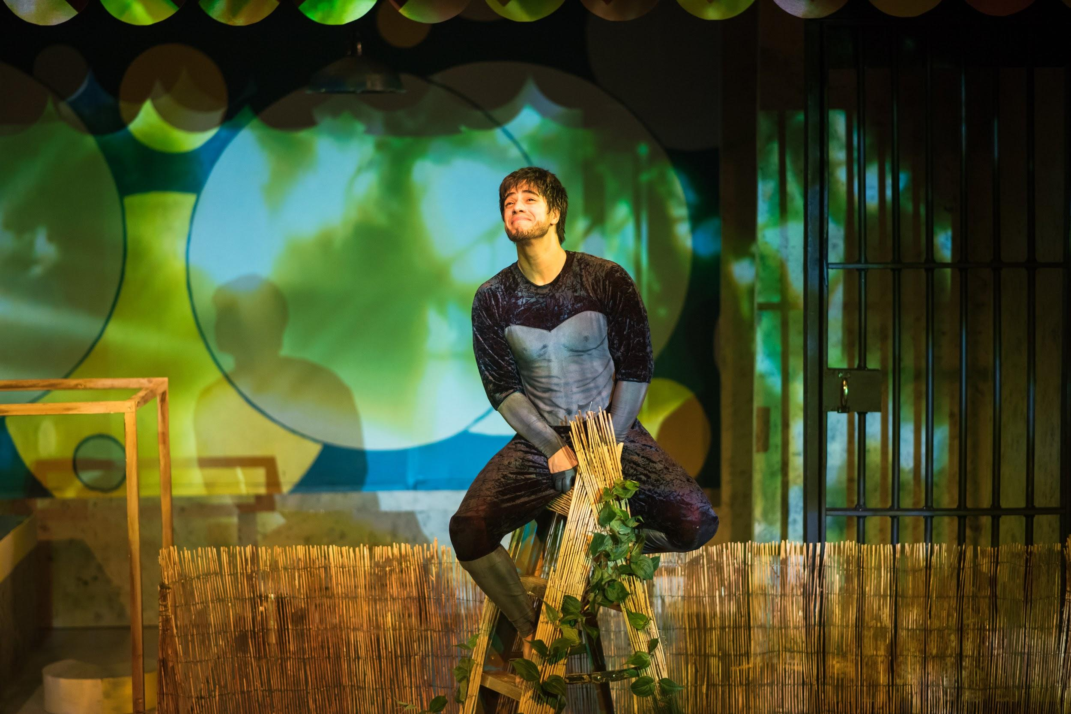
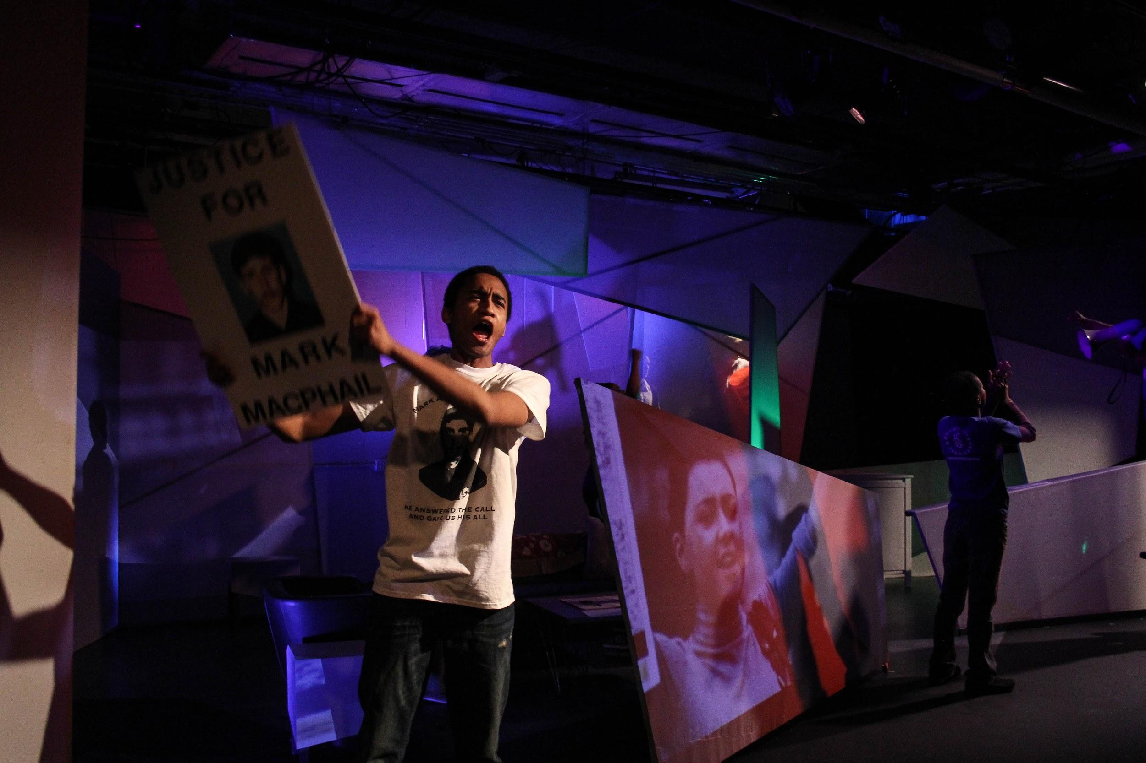
Working Strategically
to Build Audiences
Rachel May
Producing Artistic Director
Synchronicity Theatre

Slide 2
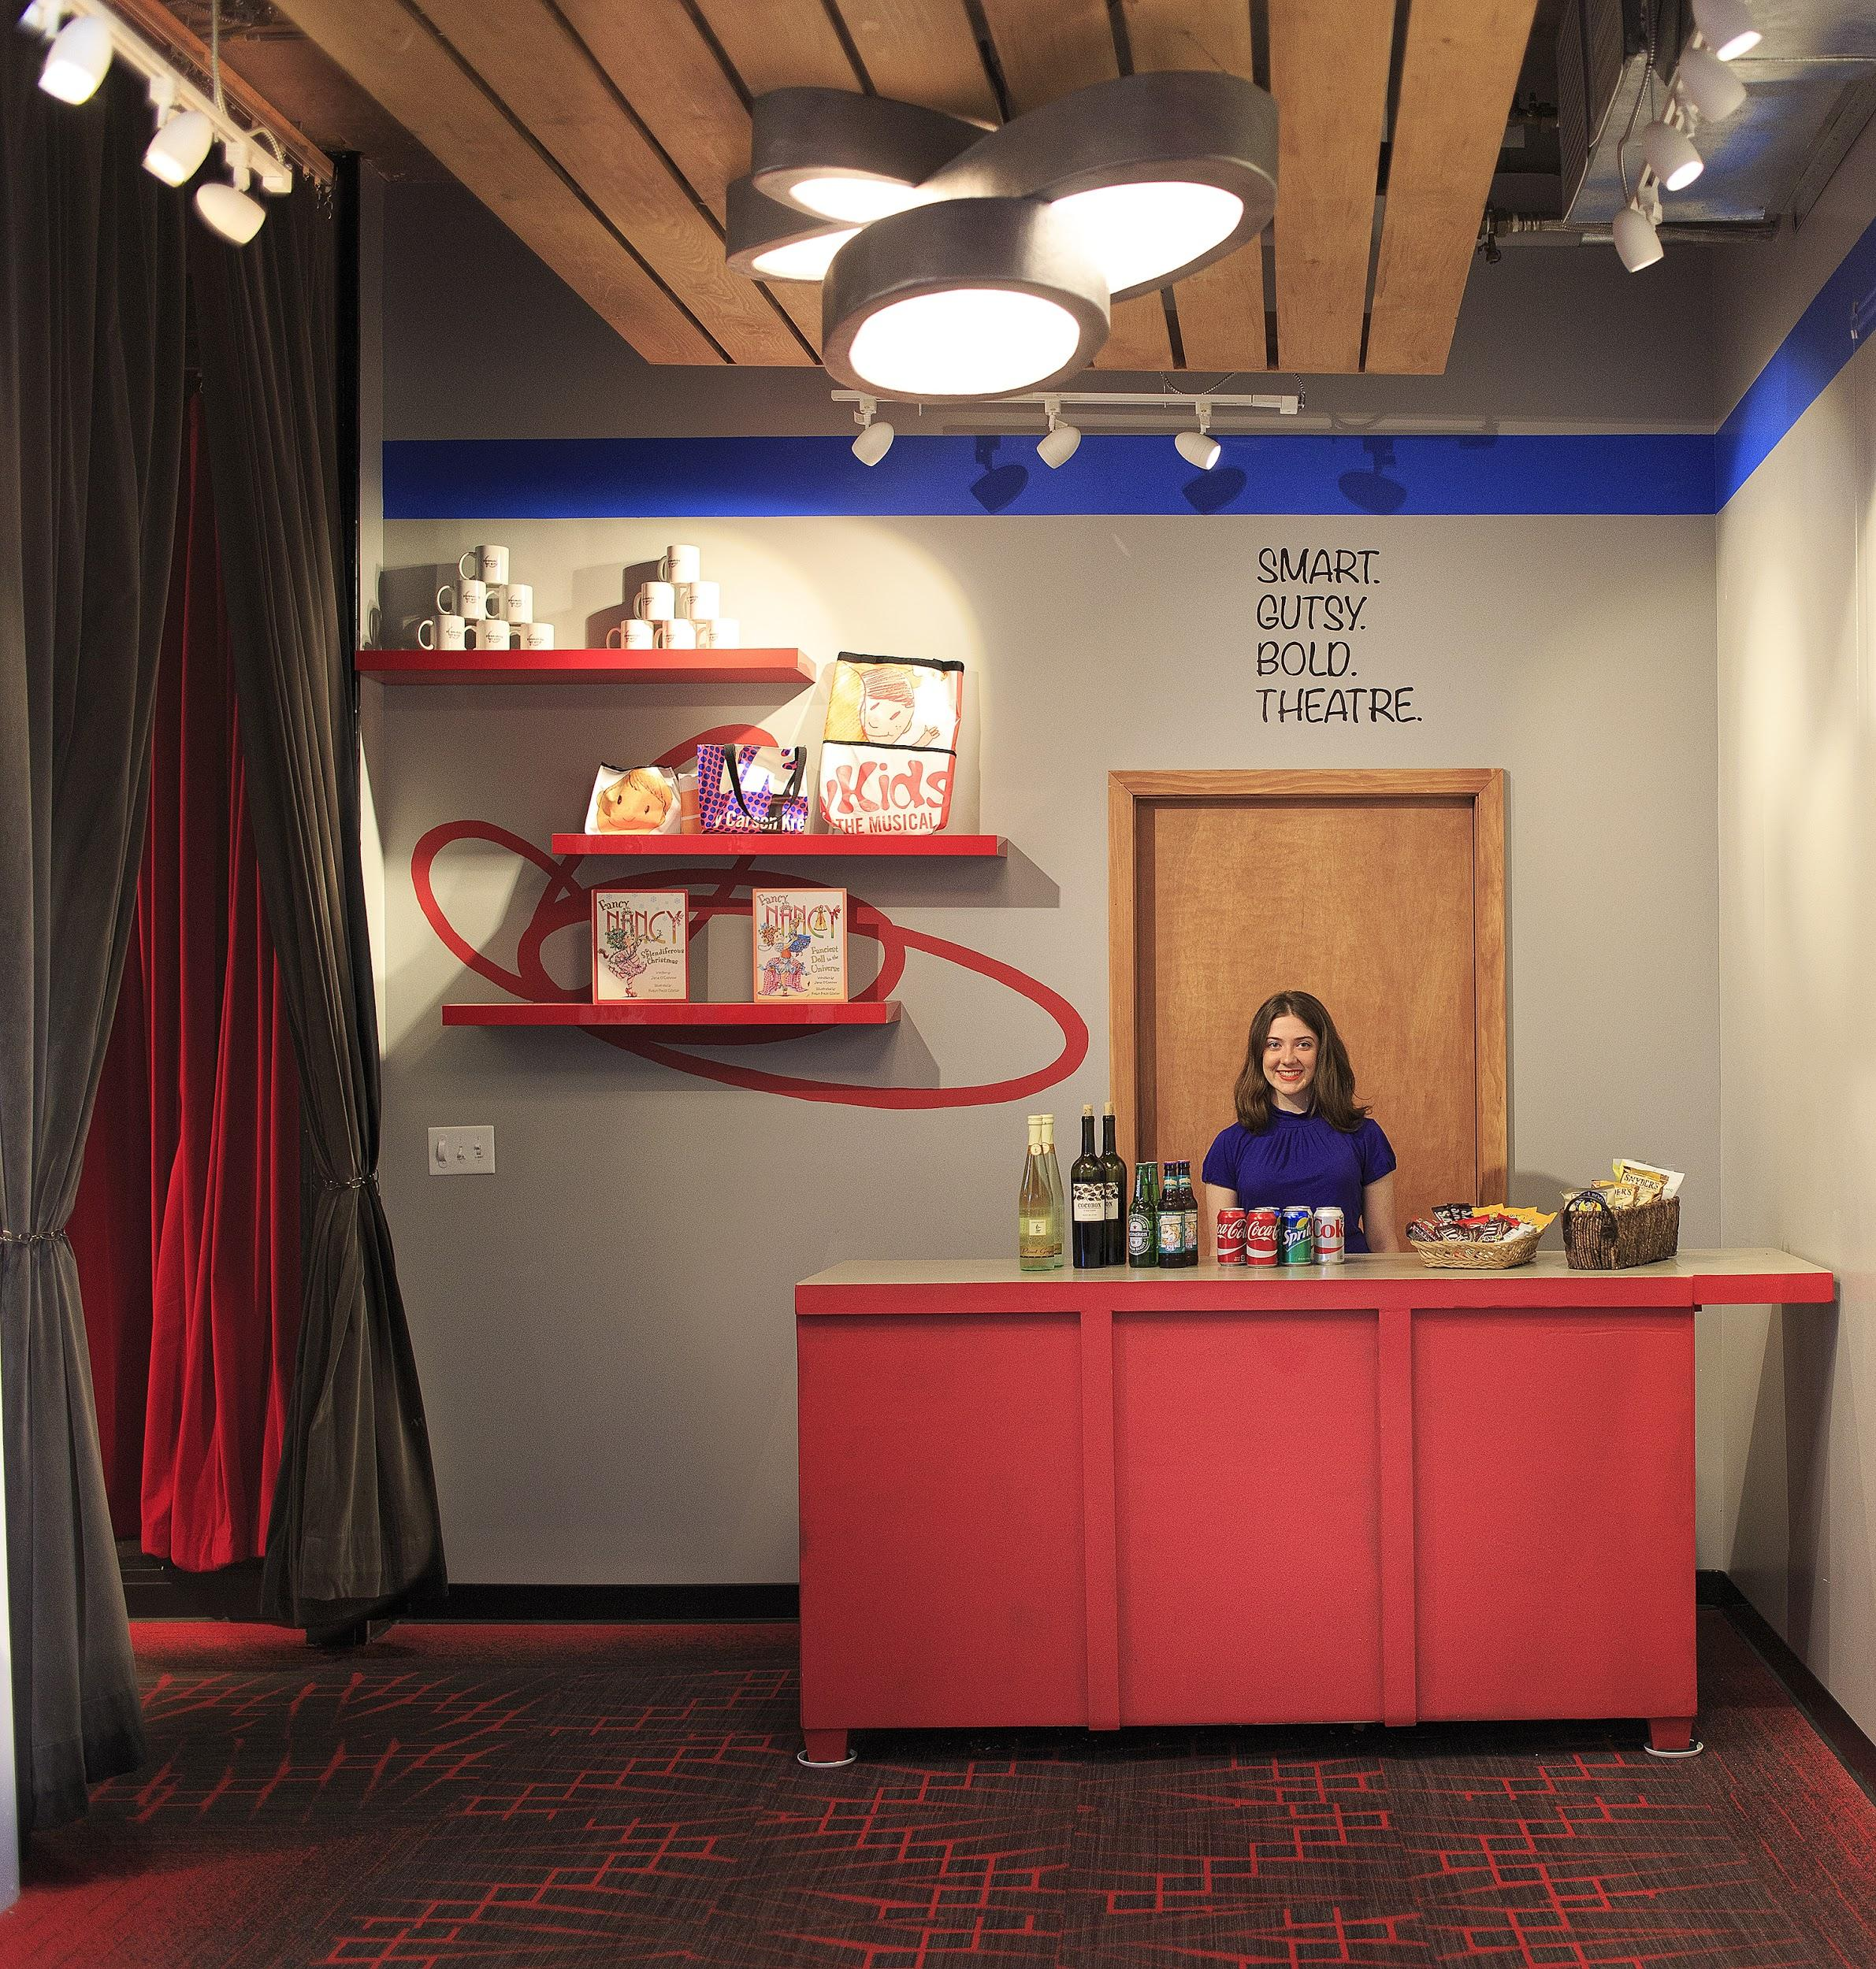
BACKGROUND: A NEW HOME
Two years ago, Synchronicity moved into our first-ever performance home. Prior to this move, we were a ‘nomadic’ company, renting from various venues around town for our productions. With tremendous support from the entire community, we renovated and opened a 140-seat house in the heart of Midtown Atlanta in the Fall of 2014. Since that time, our mandate has been clear and focused – we are working to build visibility and audiences for our work, in order to achieve our vision to uplift the voices of women and girls through great theatre.

Slide 3
WHAT WE SAID WE’D TRY
Engage in an empathy process to map our customer journey, including surveying and focus groups to garner input from our audiences.
Create an organization-wide process for better gathering and applying micro data to build loyal customers. A key component of this is the transition of our ticketing and donor management system to Spektrix, which offers tools to more deeply understand, engage with and support our patrons.
Increase our audience with consultant support from a Community Foundation Toolbox Grant (Marketing & Audience Building Consulting Grant) as well as a PR and Social Media Consultant

Slide 4
KNOW
ENGAGE
GROW

Slide 5
WHAT WE TRIED
Hired Social Media & PR Consultant to increase engagement
Transitioned ticketing and donor management to a new system, Spektrix. Began utilizing tools to more deeply understand, engage with and support our patrons, including more specialized customer segmentation in marketing communication.
Added Wednesday performances for Bold Voices shows with Pay What You Can tickets; Adjusted the time of Friday evening TYA performances and introduced “PJs and Play” concept.
Began customer journey mapping (in progress) with consultant support.

Slide 6
RESULTS

Slide 7
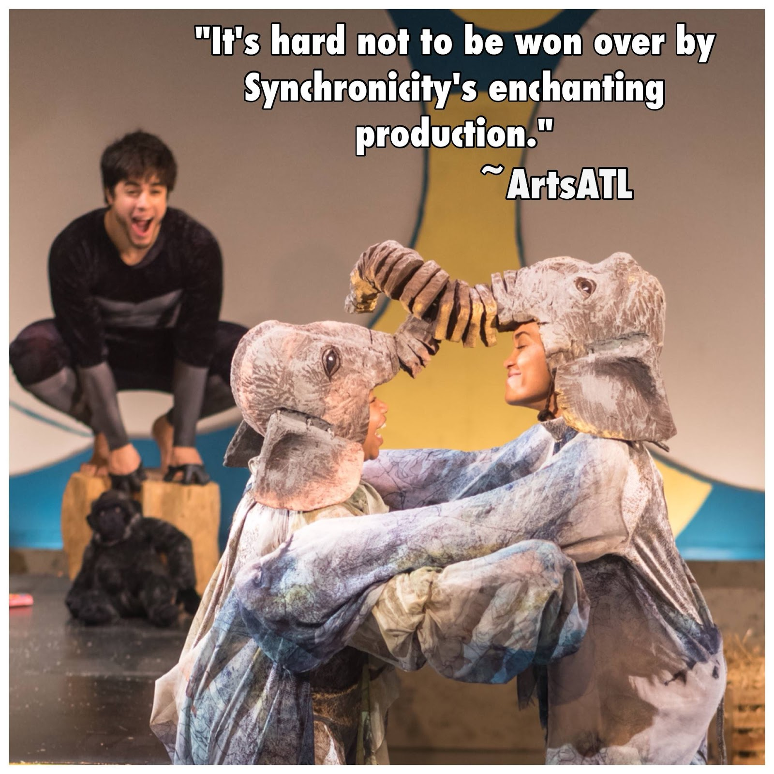
Social Media Engagement
Hiring a dedicated Social Media & PR Consultant for the season has facilitated an increase in social media engagement, press coverage and press reviews.
Our personality and behind-the-scenes activities are much stronger and more accessible to our audiences.
We have seen a big uptick in audience communication and reviews.

Slide 8
Transition to Spektrix
Spektrix is a cloud-based, user friendly patron/donor management system with unlimited training and support and additional tools that serve Synchronicity’s needs as a small theatre company!
Making the switch has enabled us to:
Respond to patrons more effectively.
Re-implement a season pass program which more than doubled our goal.
Easily segment patron data and tailor marketing messages more specifically to different audiences..

Slide 9
New Performance Experiences - PWYC
We piloted Pay What You Can Wednesday performances with our production of Anne Boleyn. Wednesday night audiences steadily grew as word spread, from 23 patrons the first Wednesday to 98 patrons the final Wednesday.
More opportunities for artists to experience our work has helped to raise the profile of our work.

Slide 10
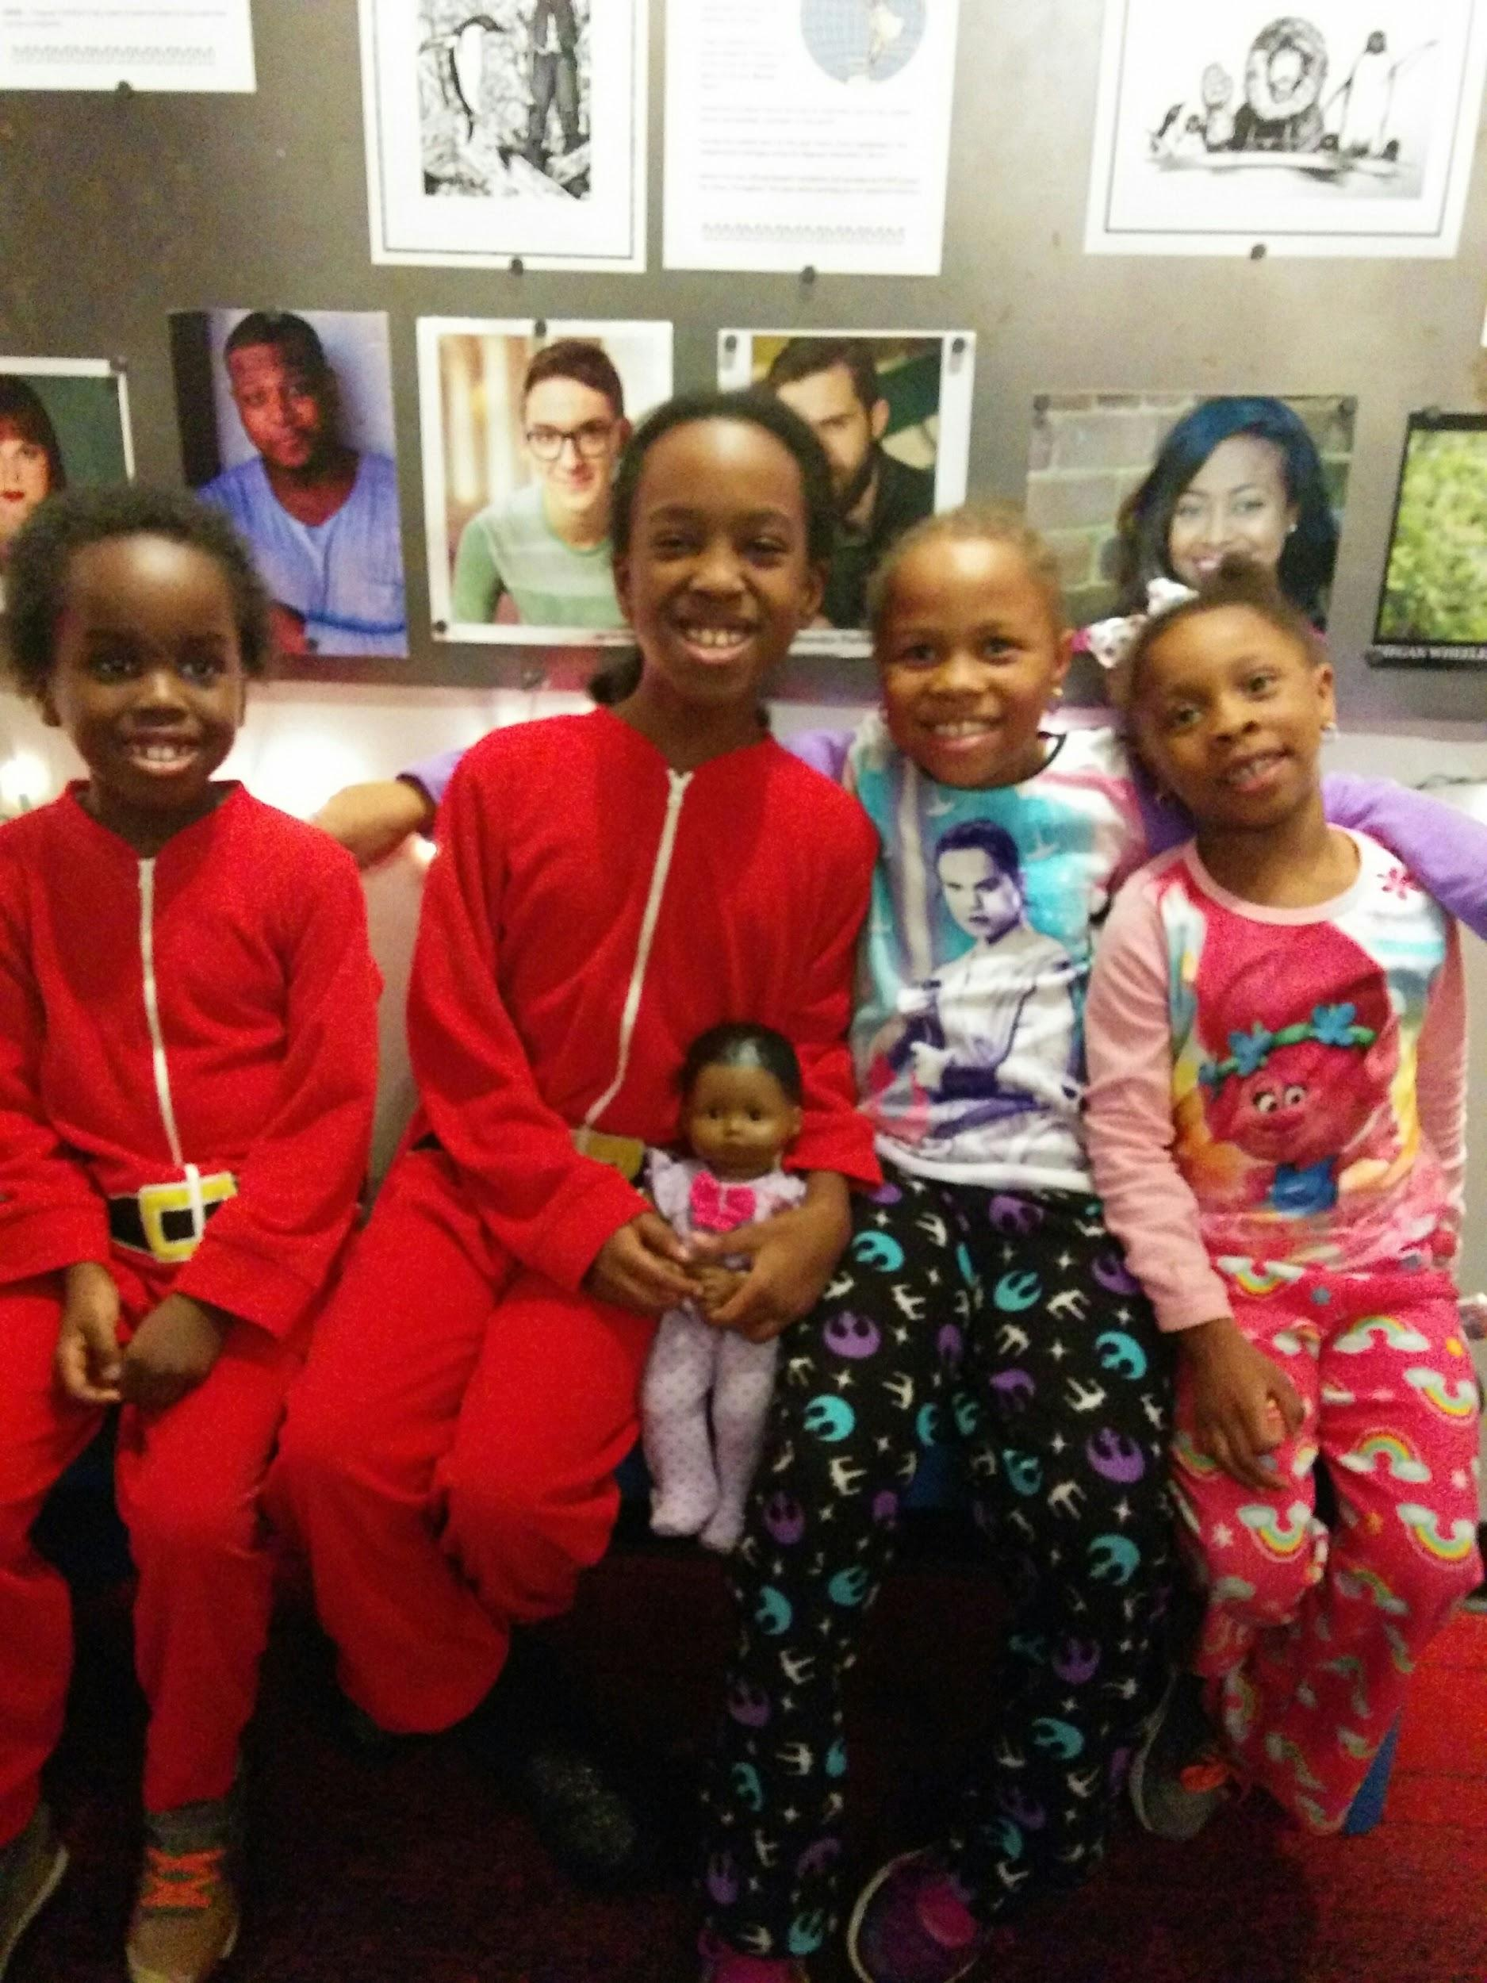
New Performance Experiences - PJs & Play
In the past, audiences were consistently tiny for Friday evening performances of our Family Series productions.
We moved the Friday Family Series performance time from 7:30pm to 7:00pm and introduced the “PJs and Play” concept: young patrons get cookies and milk and are free to wear their pajamas to the theatre!
This season, the average Friday Family Series house was 106, which is 76% capacity! Plus audiences had a lot of fun with the experience.

Slide 11
Customer Journey Mapping
We launched a customer journey mapping process with the consulting support of TRG. The project will include four components: a Patronshed analysis, social media scan, TRG Arts individual ticket plan and a journey map survey process.
We are still in the beginning stages of gathering data so no results yet...stay tuned!

Slide 12
CHALLENGES
While transitioning to a new patron/donor management system was definitely the right move for us, we did experience a learning curve this season with the move to Spektrix! We’re still learning how to utilize all of the important tools this system offers us as a small theatre.

Slide 13
RECOMMENDATIONS
Be strategic
A large portion of our grant funds supported the transition to Spektrix, which was an important strategic move for us to streamline data collection and analysis.
Utilize your resources and partners
The consultant support of TRG will enable us to analyze our data more thoroughly than we’d be able to without support.
Try something new!
Our new performance initiatives including Pay What You Can Wednesdays and Friday night PJs & Play generated great results!

Slide 14
QUESTIONS?

