Slide 1
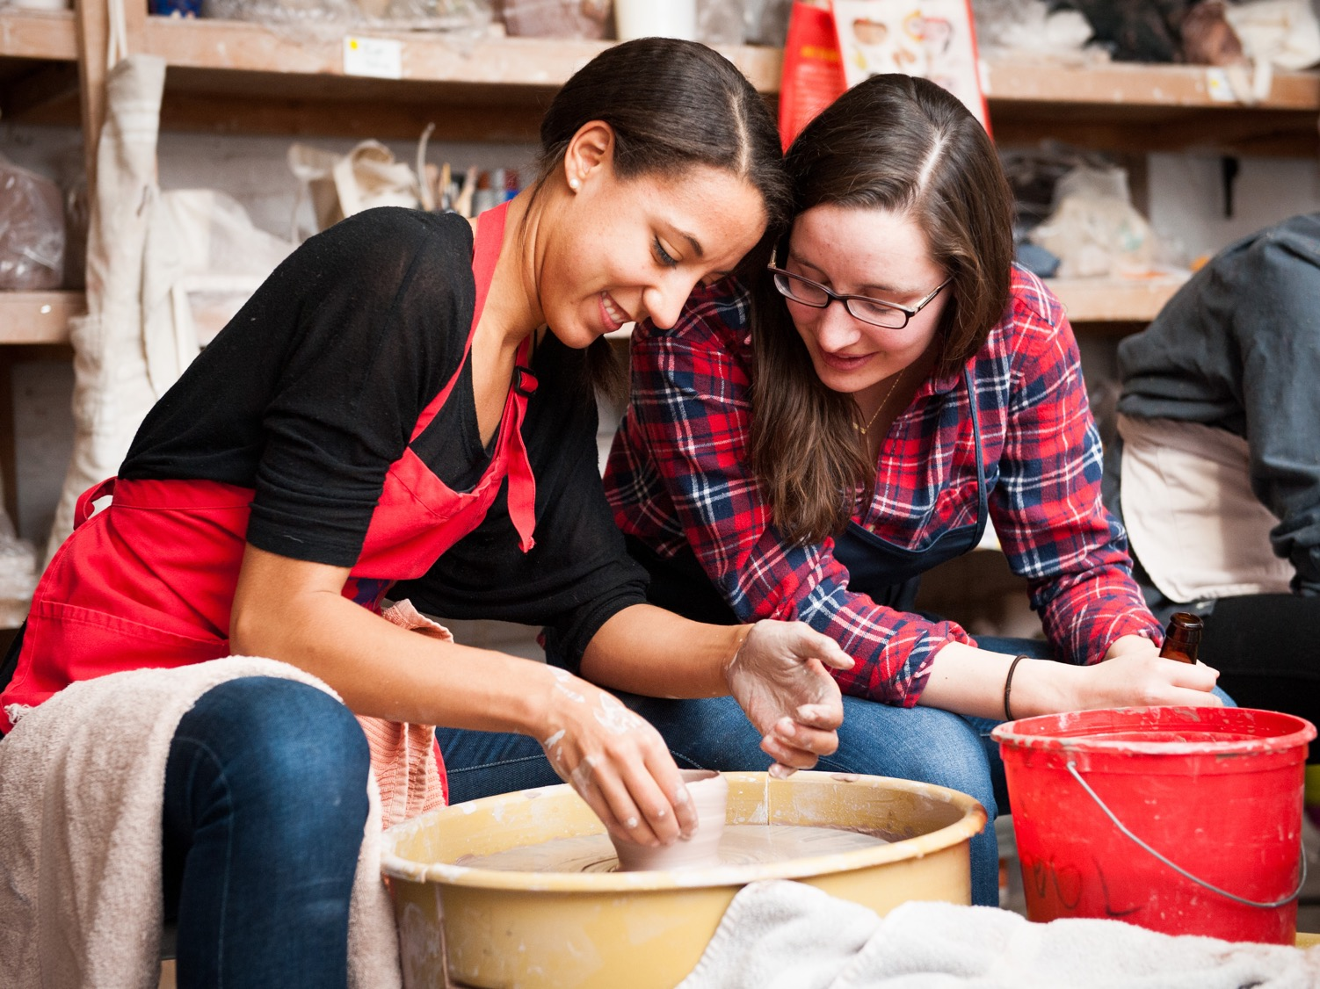
The Clay Studio, Philadelphia Chris Taylor, President
Audience: 3,600 students in workshops and classes, 30,000 visitors to artists programs and workshops
Annual budget: $1.7 million
Objective: Encourage young professionals to take part in classes and workshops

Slide 2
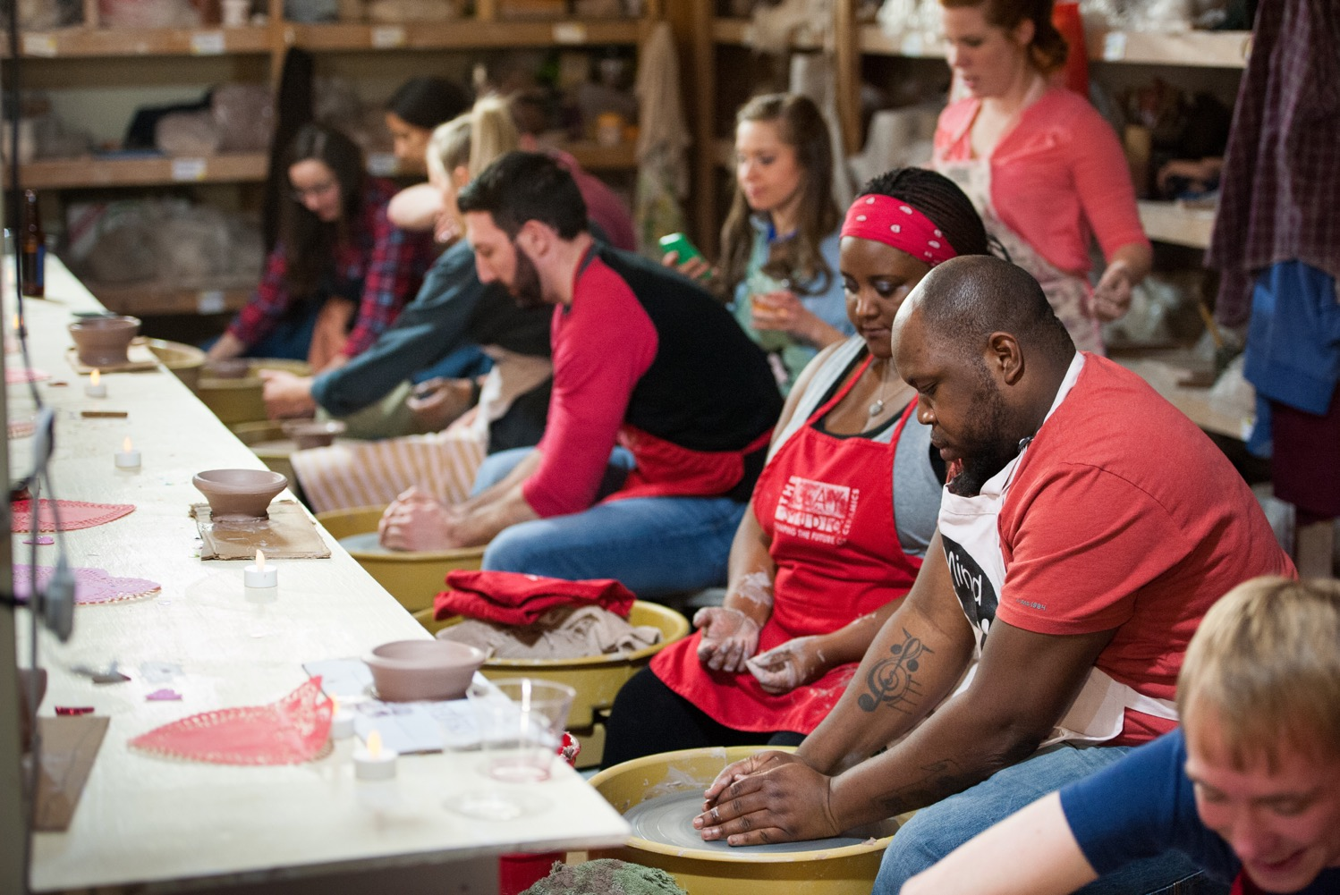
Field and other research said young adults seek participatory experiences, but are commitment shy: Shorter, lower cost

Slide 3
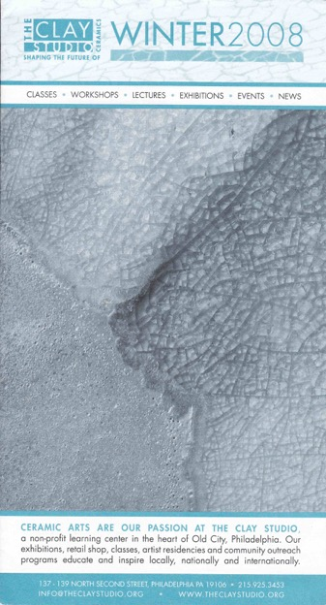
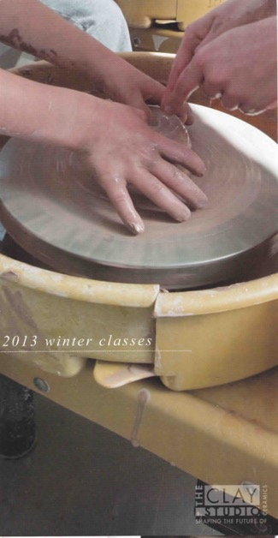
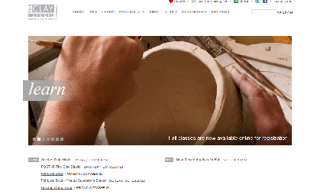
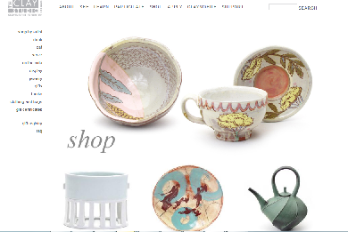
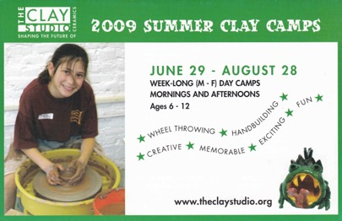
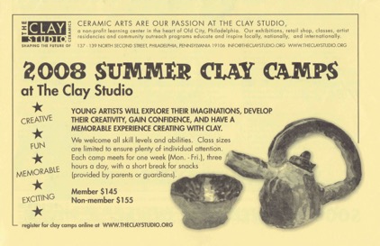
Marketing shows off the experience

Slide 4
Clay Studio triples enrollment, doubles revenue
+215%

Slide 5
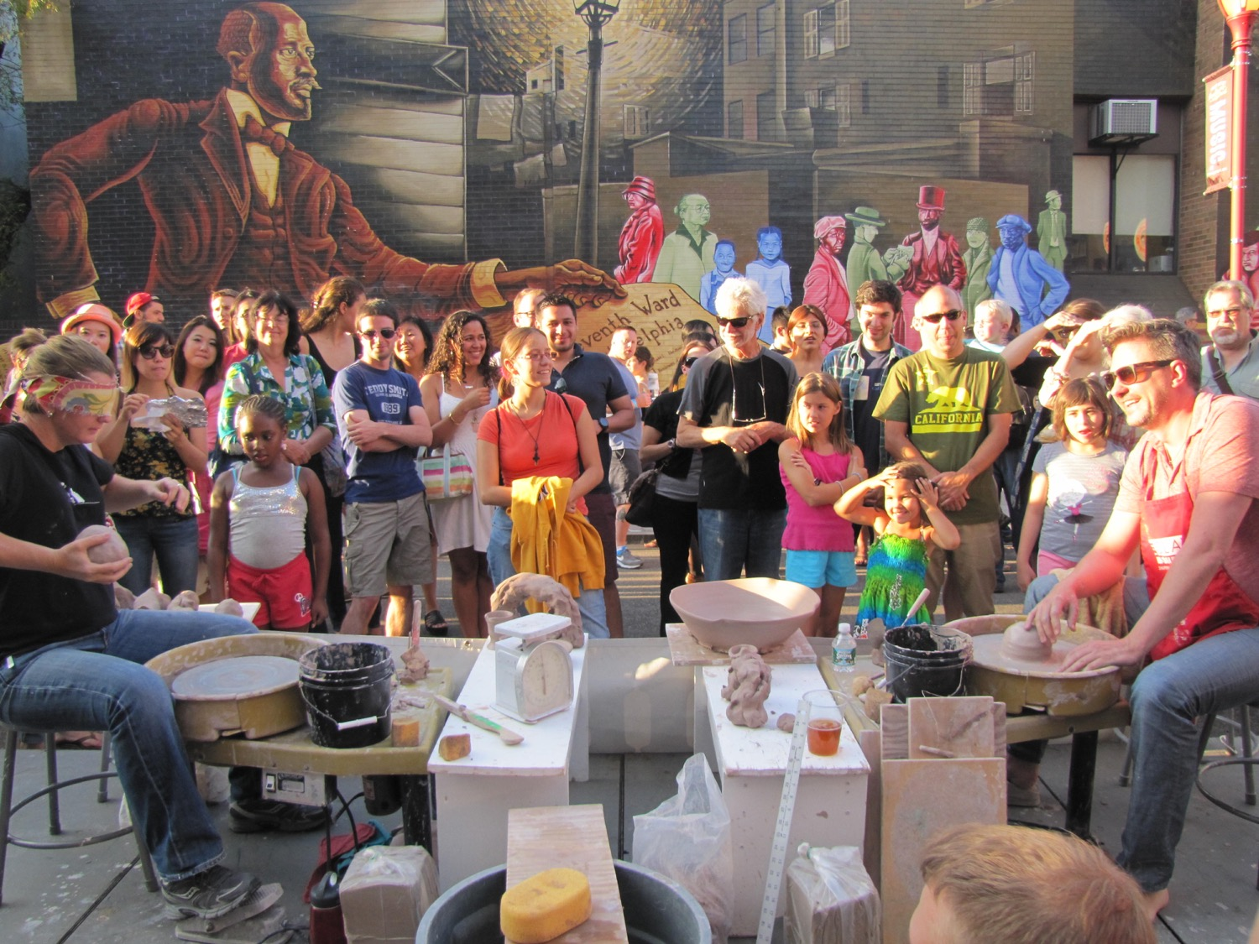

Slide 6
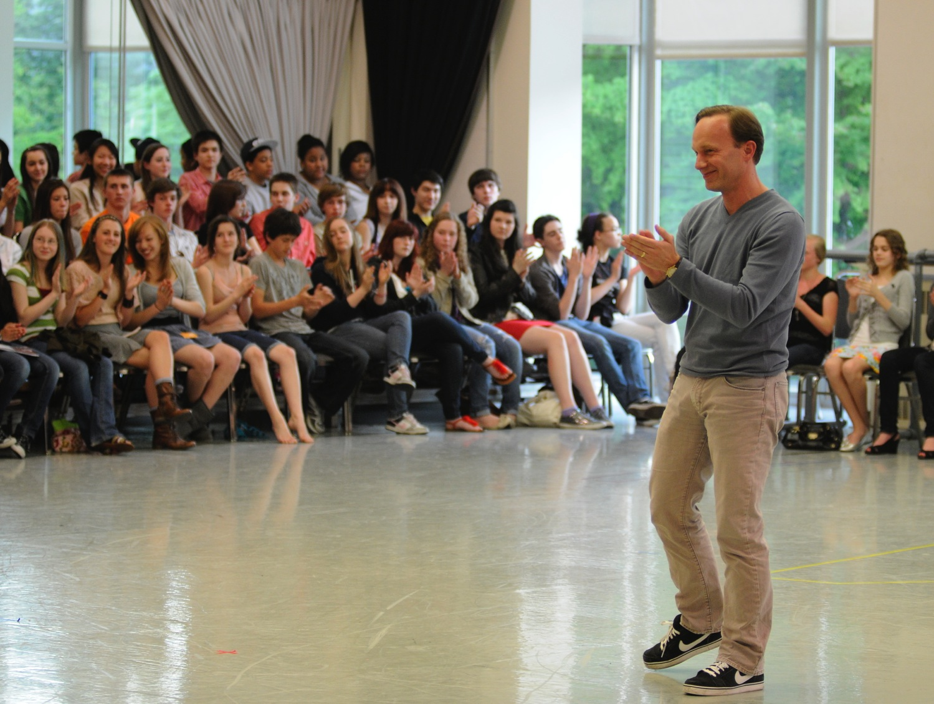
Pacific Northwest Ballet, Seattle
Ellen Walker, Executive Director
Audience: 250,000+, 100+ performances of six mixed-repertory or full-length ballets each season
Annual budget: $23 million
Objective: Encourage teens and young adults to attend performances
Notes:
This is PNB’s teen night where teens get an exclusive preview of new choreography.
The event sells out each year, and those teens typically also find their way to a performance on the mainstage, and PNB has seen it’s teen audience double at a time when the national trend is toward decline

Slide 7
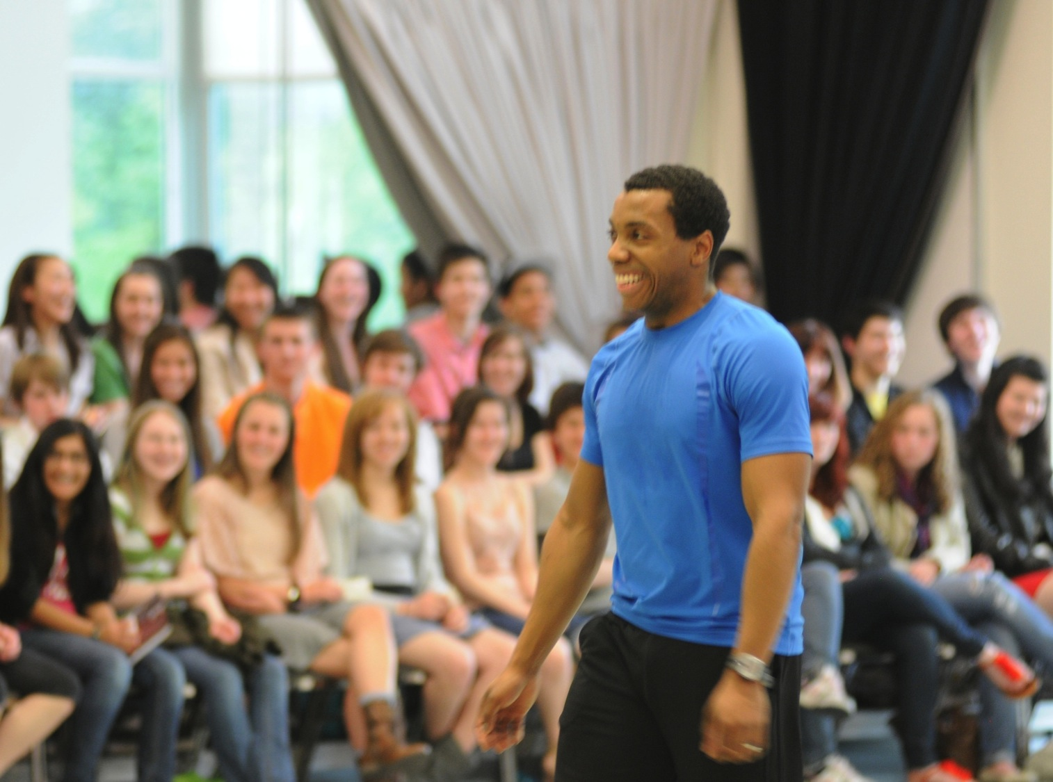
Teens and young adults said PNB hard to get to know—weren’t sure what it was about, if they would feel welcome.
Response: Provide multiple ways to get to know PNB
Teen Night, $10 rehearsal previews, 25 & Under, TeenTix
Notes:
Teen night especially good for young people, the PNB artists are their age
Doesn’t stop here…all kinds of ways to get to know PNB

Slide 8
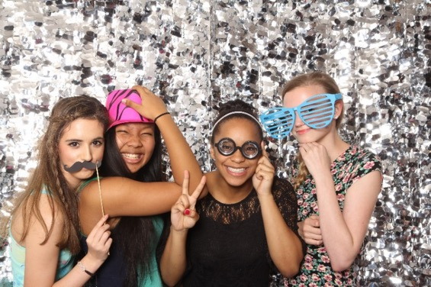
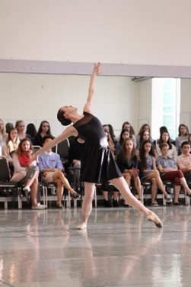
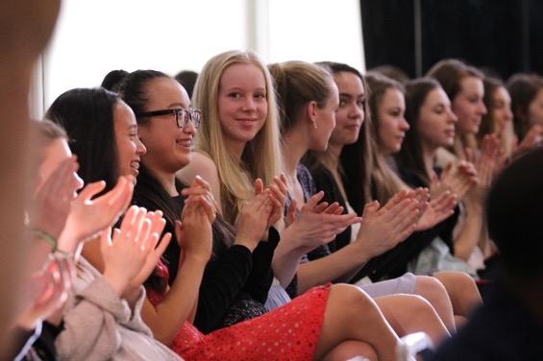
PNB/WEA: Snapshot of Results
Huge growth among 13-19 year olds (238% increase in attendance)
More modest increase among 19-25 year olds (20% increase in attendance)
Sustained participation at 55% among target groups
Less success with attraction and retention of 25-40 year olds

Slide 9
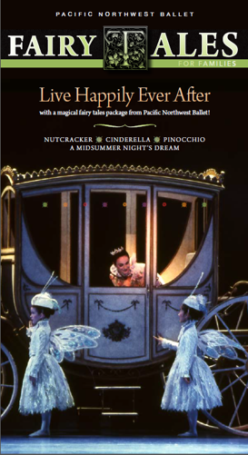
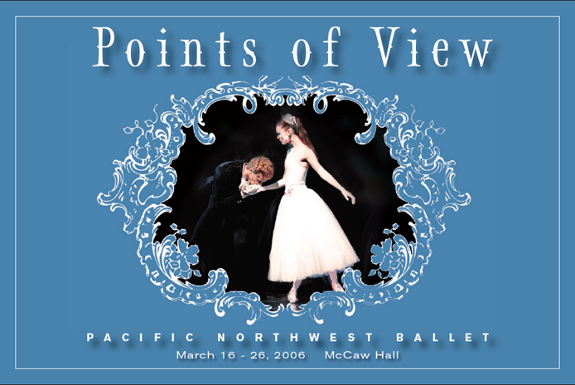
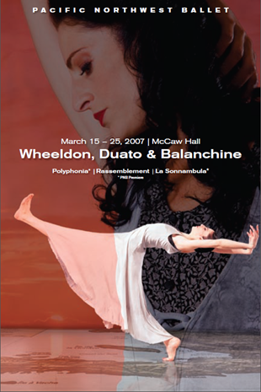
Evolution of Collateral: Before

Slide 10
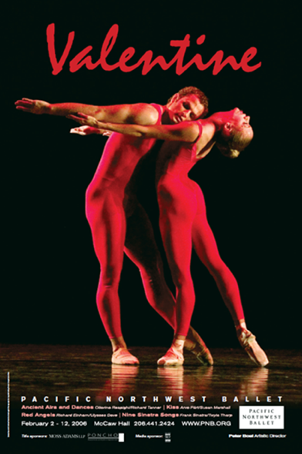
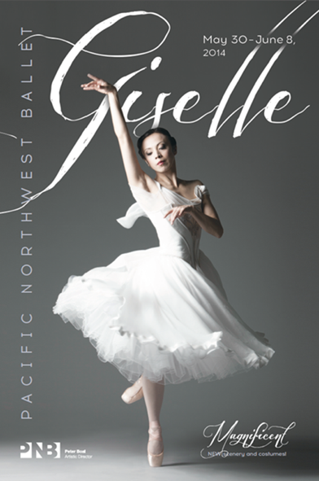
Evolution of Collateral: After
Before After
Focus on evocative visuals or faces/moments, rather than ballet positions or performance photos
Consistent institutional branding: open vs. exclusive
Balance between accessible tone of voice and informative content
Age-based offers

Slide 11
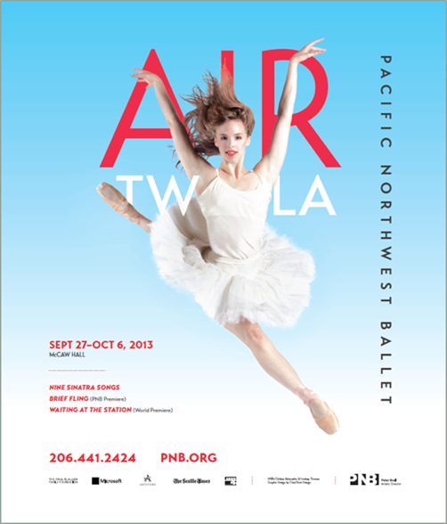
Evolution of Collateral: After

Slide 12
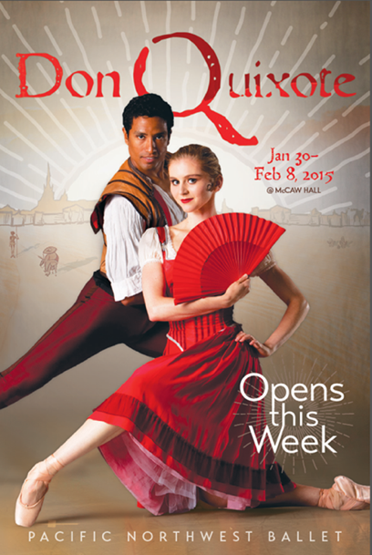
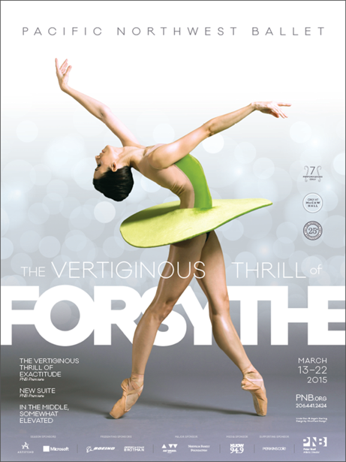
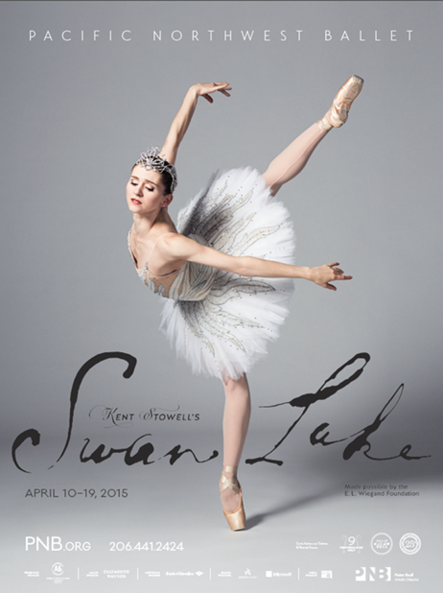
Evolution of Collateral: After

Slide 13
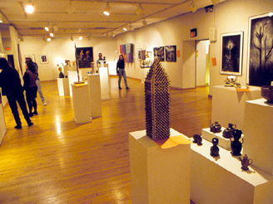
Fleisher Art Memorial, Philadelphia Magda Martinez, Director of Programs
Founded in 1898 by industrialist Samuel S. Fleisher
Audience includes 4,000 youth and adults in free and low-cost classes, in addition to programs in schools and community centers
Annual budget: $2 million
Objective: encourage more residents in its changing neighborhood to enroll in onsite programs

Slide 14
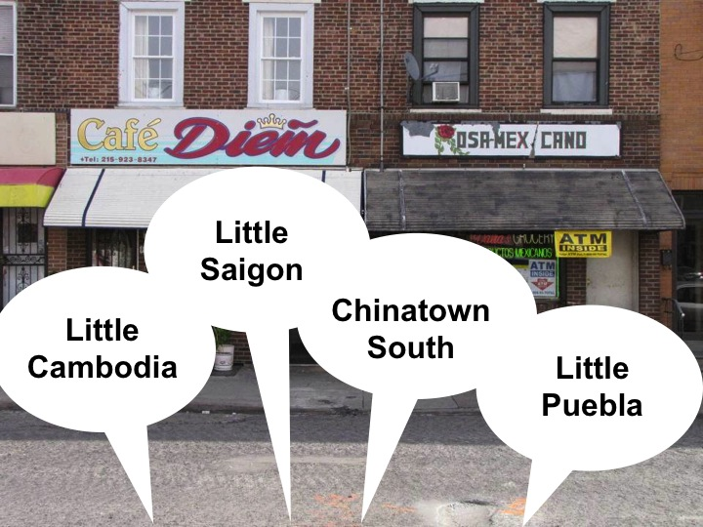

Slide 15
The Fleisher engagement mantra emerges from research
Come to us
Show us
Welcome us
We might hesitate to go to you, but If you come to us, we’d have more confidence.
We don’t understand what happens at Fleisher. Don’t just tell us, show us.
It’s like you’re lifted above us. But If you let us know you’re accessible, we’ll be there.
Notes:
From the initial research with Slover, Linnet emerged there main cardinal points on the directional compass.
Come to us – come to our communities the places we feel comfortable
Show us- show us what you do, who you are, not only as an institution but as people
Welcome us- If we decide to come to you be ready to help us feel welcome. This has guided our community engagement programming and our staff training.

Slide 16
Welcome Us: Transforming Institutional Culture
All staff participated in:
Cultural competency training
Research and strategy brown bag lunches
Community engagement workshops
Site visits to community partners
Notes:
They started by preparing themselves and by learning about themselves.
As a first step, the entire staff—from visitor services part-time employees to department managers and the executive director—attended cultural competency training provided by an outside organization specializing in teaching organizations about how to accommodate and welcome diverse cultures and perspectives.
The training was intended to raise consciousness of how culture impacts perceptions and communication styles, as well as to impart skills to understand and communicate with people from a range of backgrounds. It also provided a forum for staff conversations about the community engagement work and the role staff would play in bringing it to fruition, and to help staff take steps toward becoming more invested in that work.
For all staff:
Brown bag lunches
Diversity training – discussions around race, ethnicity, equality/equity
Reviewing our printed materials, website, social media, media outlets and programming. What/how we can change and grow. We are learning to learn.
A few of the topics included things that would help them get outside their doors and understand the community
Relationship Building
Collaborations and Partnerships; Agencies, Organizations, and Resources in Southeast Philadelphia
Community Arts Strategies and Programming for New Audiences
Language Strategies for Working with English-Language Learners
Site visits:
The Italian Market area shops and vendors
Cambodian Association of Greater Philadelphia, Mifflin Square Park, and Preah Buddha Rangsey Cambodian Temple and Community Center
Annunciation B.V.M. Church Hispanic Outreach Center
Although staff in some departments had longstanding relationships with several community organizations, many people who worked in the building had never visited Fleisher’s community programs or had contact with these partner organizations. Everyone—from facility staff to the executive director and members of the Board—took part in at least three field visits to different community operations, including the following:
A series of new programs got them into the communities and helped them build those bridges

Slide 17
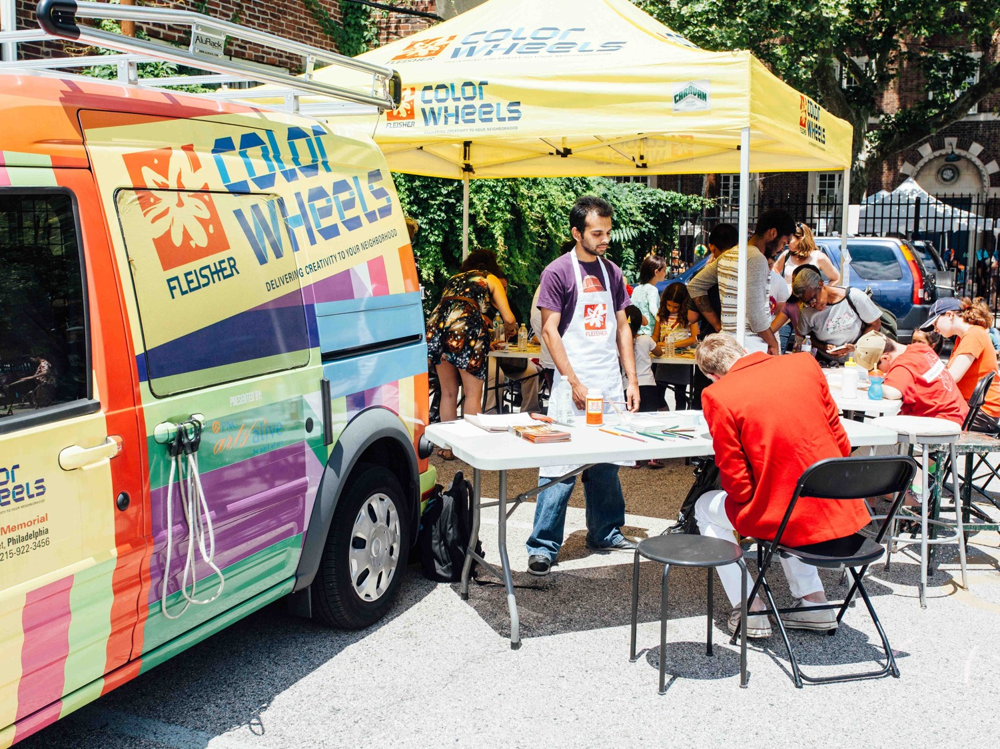
Come to us, Show us: Color Wheels
Notes:
ColorWheels
Fleisher’s mobile art studio. That has served approximately 2,500 adults, children and families in 2 years. Received startup funding through PNC Arts Alive program.

Slide 18
Changing Perceptions of Fleisher Art Memorial
2009
2012
36% of students in youth/child classes now come from surrounding neighborhood, up from 25%

Slide 19
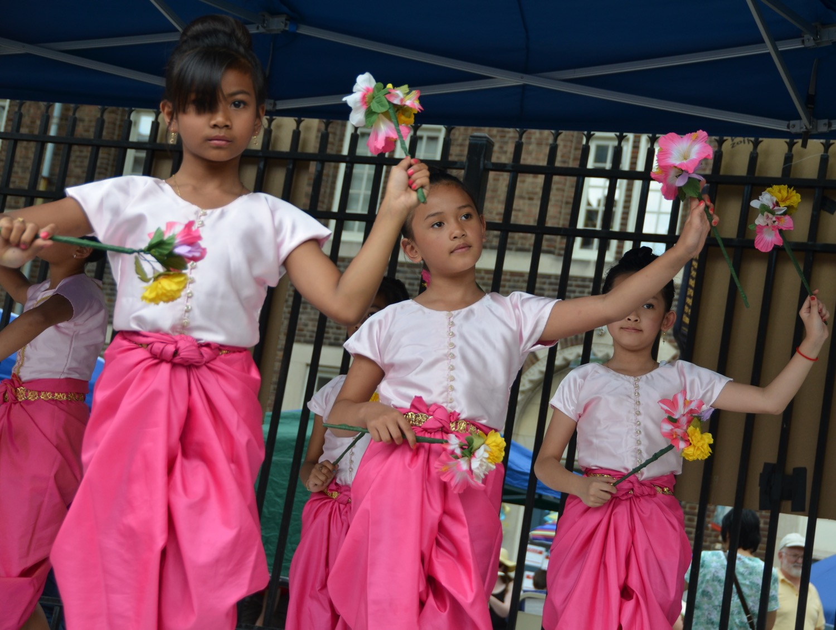
Additional $350,000 of community engagement support from organizations such as Pew Center, Barra Foundation and PNC benefit entire organization
Marketing communications
Website redesign
Enrollments from community liaisons

